Slide 1
Computational Rhythm and Beat Analysis
Nick Berkner

Slide 2
Goals
Develop a Matlab program to determine the tempo, meter and pulse of an audio file
Implement and optimize several algorithms from lectures and sources
Apply algorithm to a variety of musical pieces
Objective and Subjective analysis of results
By studying which techniques are successful for different types of music, we can gain insight to a possible universal algorithm

Slide 3
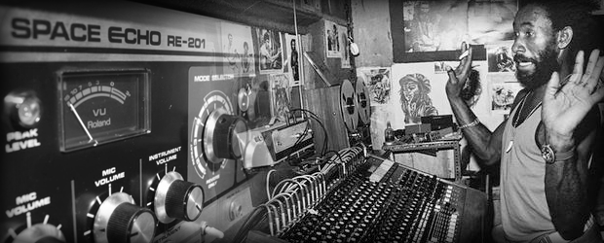
Motivations
Music Information Retrieval
  Group music based on tempo and meter
Musical applications
  Drum machines
  Tempo controlled delay
  Practice aids

Slide 4
Existing Literature
Perception of Temporal Patters
  Dirk-Jan Povel and Peter Essens
Tempo and Beat Analysis of Acoustic Musical Signals
  Eric D. Scheirer
Pulse Detection in Synchopated Rhythms using neural oscillators
  Edward Large and Marc J. Velasco
Music and Probability
  David Temperley

Slide 5
Stage 1
Retrieve note onset information from audio file
  Extracts essential rhythmic data while ignoring useless information
Variation of Scheirer’s method
Onset Signal
  Same length as input
  1 if onset, 0 otherwise
Duration Vector
  Number of samples between onsets
Create listenable onset file

Slide 6
Ensemble Issues
Different types of sounds have different amplitude envelopes
  Percussive sounds has very fast attack
  This leads to the envelope having higher derivative
When multiple types of sounds are present in an audio file, those with fast attack rates tend to overpower others when attempting to find note onsets
Can use a bank of band pass filters to separate different frequencies
Different thresholds can be used so that the note onsets of each band can be determined separately and then added

Slide 7
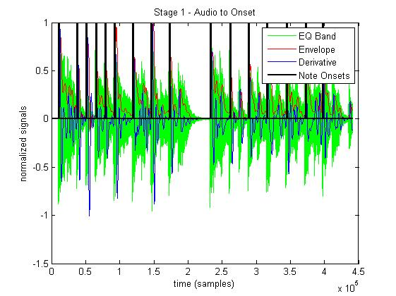
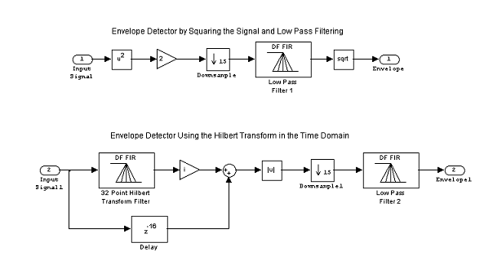

Finding Note Onsets
Envelope Detector

Slide 8
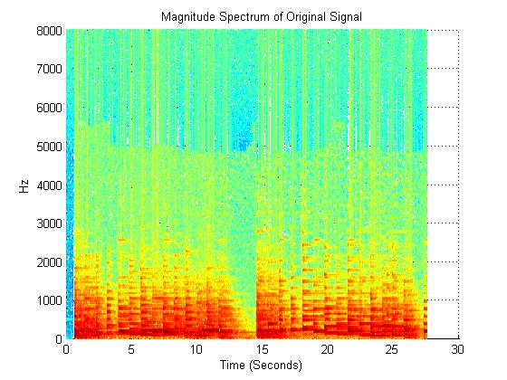
Further Work
Algorithm to combine onsets that are very close
Optimize values for individual musical pieces
  Modify threshold parameters
  Smoothen the derivative (low pass filter)
Explore other methods
  Energy of Spectrogram

Slide 9
Stage 2
Determine tempo from note onsets
Uses customized oscillator model
  Comb Filters have regular peaks over entire frequency spectrum
  Only “natural” frequencies (0-20Hz) apply to tempo
Multiply onset signal with harmonics and subharmonics of pulse frequency and sum the result
  Tempo = 60*frequency
The tempo of the piece will result in the largest sum
Perform over range of phases to account for delay in audio

Slide 10
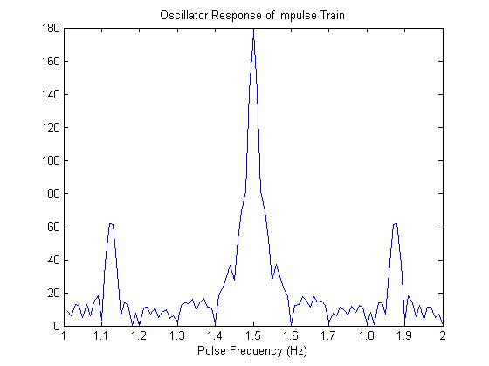
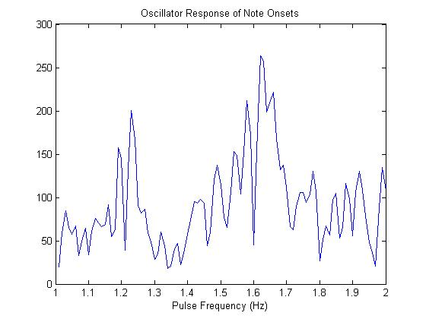
Finding Tempo
Tempos that are integer multiples of each other will share harmonics
  Tempo range = 60-120 BPM (1-2 Hz)
The tempo and phase can be used to create audio for a delayed metronome for evaluation
97.2 BPM

Slide 11
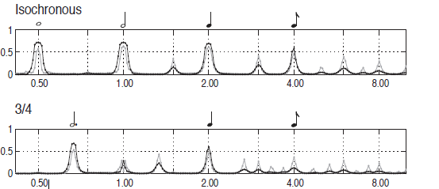
Further Work
Implement neural oscillator model
  Non-linear resonators
  Apply peak detection to result
    Can also be used to find meter
Explore other methods
  Comb filters and autocorrelation
  Use derivative rather than onsets

Slide 12
Quantization
Required for implementation of Povel-Essens model
Desain-Honing Model
Simplified approach
  Since tempo is known, we can simply round each duration to the nearest common note value
  For now assume only duple meter metrical values (no triplets)
  Example: Duration = 14561, Tempo = 90 BPM, Sample Rate = 44100 Hz
    Tempo frequency = 90/60 = 1.5
    Quarter = 44100/1.5 = 29400 samples, Eighth = 14700, Sixteenth = 7350
    → Eighth note

Slide 13
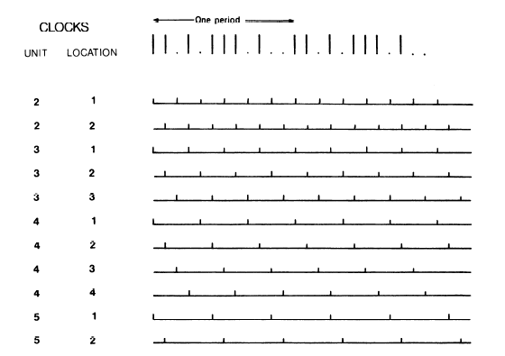
Stage 3
Determine the meter of a piece
The time signature of a piece is often somewhat subjective so the focus is on choosing between duple or triple meter
Povel-Essens Model
Probablisitic Model

Slide 14
Evaluating Performance
Test samples
  Genres: Rock, Classical
  Meter: Duple, Triple, Compound (6/8)
  Instrumentation: Vocal, Instrumental, Combination
  Control: Metronome
Greatest challenge seems to be Stage 1, which effects all subsequent stages, and is also effected the most by differences in genre and instrumentation.
  Versatility vs. Accuracy

