Slide 1

Speech Enhancement through Noise Reduction
By
Yating & Kundan

Slide 2
What is Speech Enhancement?
Process of improving perceived speech quality that has been degraded by background noise at the listener side through the use of various audio signal processing techniques and algorithms.

Slide 3
Noise
“Refers to signal that are unpredictable in nature and carry no useful information”
Classification
Stationary: remains unchanged over time such as the fan. Such sources of noise are also called “noise like”.
Non-Stationary: wherein noise is constantly changing w.r.t time for ex restaurant, public places like bus stand, air terminal etc.

Slide 4
Noise Sources
Noise can get added over the communication channel due to co-channel interference.
Noise can also get generated at the receiver itself like ( a.k.a additive noise)
  Shot Noise: generated by individual electrons as they travel through a conducting substance. It’s proportional to the amount of electric current flowing through the conductor.
  Thermal Noise: caused by the random motion of electrons which is directly proportional to thermal energy / conductor temperature.
Other sources of noise can be disturbances added from the background environment of the transmitter / speaker. These may be sounds of wind, keyboard typing, people, birds & animals, traffic, industrial machinery, restaurant etc.

Slide 5
Objective of Speech Enhancement Algorithms
speech enhancement algorithms aim to suppress the noise without introducing any perceptible distortion in the signal.
Performance depends upon the number of microphones available at the receiver. Typically, the larger the number of microphones, the easier the speech enhancement task becomes. For Adaptive cancellation at least one microphone is required near the noise source.

Slide 6
Applications..
Noise cancellation algorithms are used in following applications:
mobile phones
VoIP
teleconferencing systems
speech recognition
hearing aids
Air to Ground communication between ATC and Pilot

Slide 7
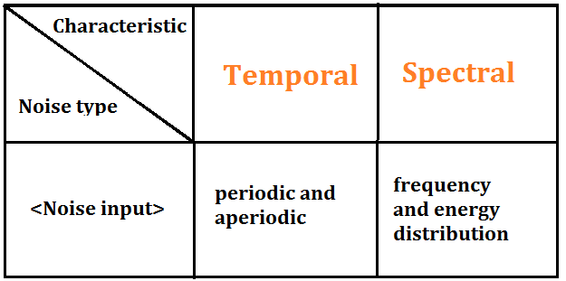
Noise characteristics
Can be classified into following parameters..

Slide 8
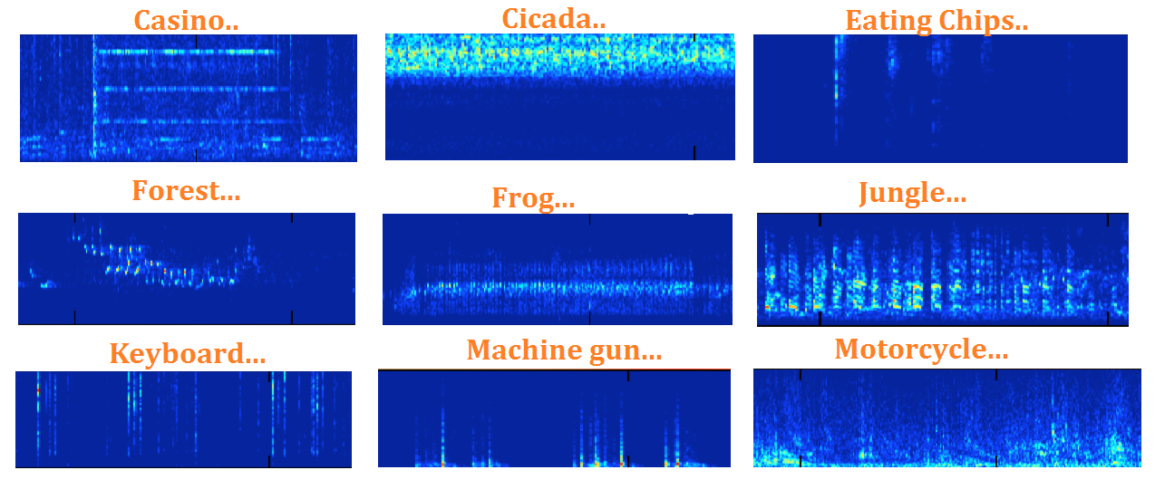
Spectrogram of different noise sources

Slide 9
What is an adaptive algorithm ?
“Adaptive” because the algorithms don’t require a priori knowledge of the signal or noise characteristics.
Adaptive noise cancellation algorithms require two or more
microphones. One to capture “speech + noise” signal while the other to capture the “noise signal” alone. Generally, the former micro phone is at the top of the handset while the later is at the bottom of the handset.
The microphones need to be separated in order to prevent the speech being included in the noise reference.
Using the two microphone inputs, coefficients of an adaptive
filter are adaptively adjusted to remove the noise from the noisy signal. This is achieved by passing the “noise reference” input through the adaptive filter.

Slide 10
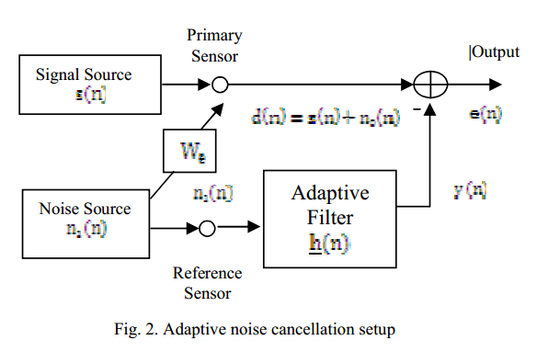
Generic Logic diagram

Slide 11
Basic Working principle
Primary Input = S(n) + n₀(n) .
Secondary input or reference noise input = n₁(n).
The noise reference passes through the adaptive filter, which then generates an output “y(n)” which is a close replica of “n₀(n)”.
The filter readjusts itself continuously to minimize the error between “n₀(n)” and “y(n)”.
The output “y(n)” is subtracted from the primary input “S(n) + n₀(n)” to produce the de-noised signal or Noise cancelled speech signal.

Slide 12
Implementations…
Adaptive Algorithms implemented in this project:
1. LMS (Least Mean Squares).
2. NLMS (Normalized Least Mean Squares).
3. RLS (Recursive Least Square).
Best convergence and the ultimate in performance!!
4. LPC ( Linear Predictive Coding ).

Slide 13
Working Principle..
LMS (Least Mean Square)
Parameters:
reference signal x(n)
Filter weights = w(n)
output signal y(n) = conv [x(n),w(n)].
Filter output = y(n)
estimation error e(n) = d(n) - y(n)
primary sensor receives noise x1(n) which has correlation with noise x(n) in an unknown way.
Objective is to minimize the error signal e(n) by incrementally adjusting filter’s weights for the next time instant. i.e. “uses error signal to calculate filter coefficients”

Slide 14
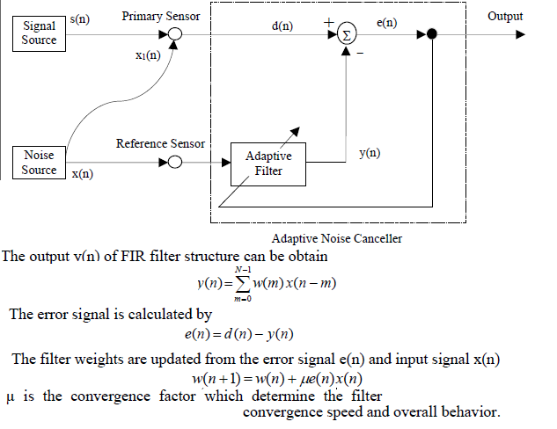

Slide 15
Working Principle..
NLMS ( Normalized LMS )
Slight variation of LMS algorithm.
In LMS, for large values of convergence factor “µ”, the algorithm experiences gradient noise amplification problem.
NLMS tackles this problem by including a time varying step size in calculation of the convergence factor.

Slide 16
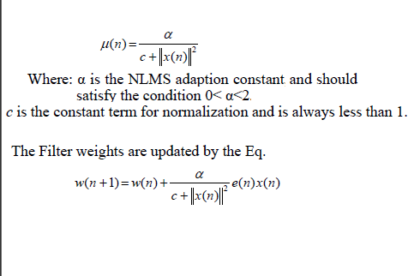
NLMS contd..

Slide 17
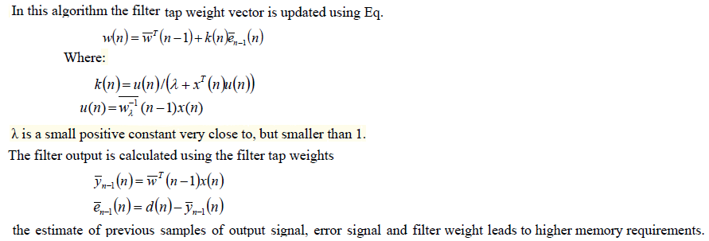
Working Principle..
RLS (Recursive Least Square)

Slide 18
Working Principle..
LPC ( Linear Prediction Coefficient)
The clean speech signal is windowed and STFT analysis is performed.
The LPC coefficients are calculated then.
Filter the noise signal with the LPC co-efficient.
Overlap add all the frames.

Slide 19
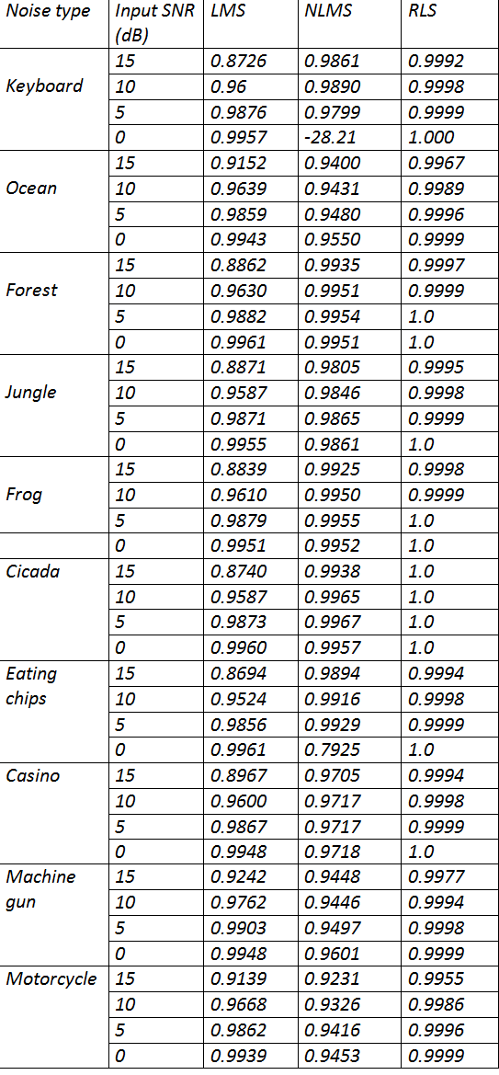
Results..

Slide 20
Comparison between LMS, NLMS and RLS for input SNR = 15 dB

Slide 21
Comparison between LMS, NLMS and RLS for input SNR = 10 dB

Slide 22
Comparison between LMS, NLMS and RLS for input SNR = 5 dB

Slide 23
Comparison between LMS, NLMS and RLS for input SNR = 0 dB

Slide 24
Performance Comparison
The best performance was observed by
RLS> NLMS > LMS> LPC
Comparison:
RLS: high computational complexity is the weak point of RLS but it was observed to have faster convergence. And hence the ultimate amongst all the rest.
LMS and NLMS : are the most commonly used because of low computational complexity.
The worst performance was of Priori SNR method and the restored signal has too many audible clipping sound.

Slide 25
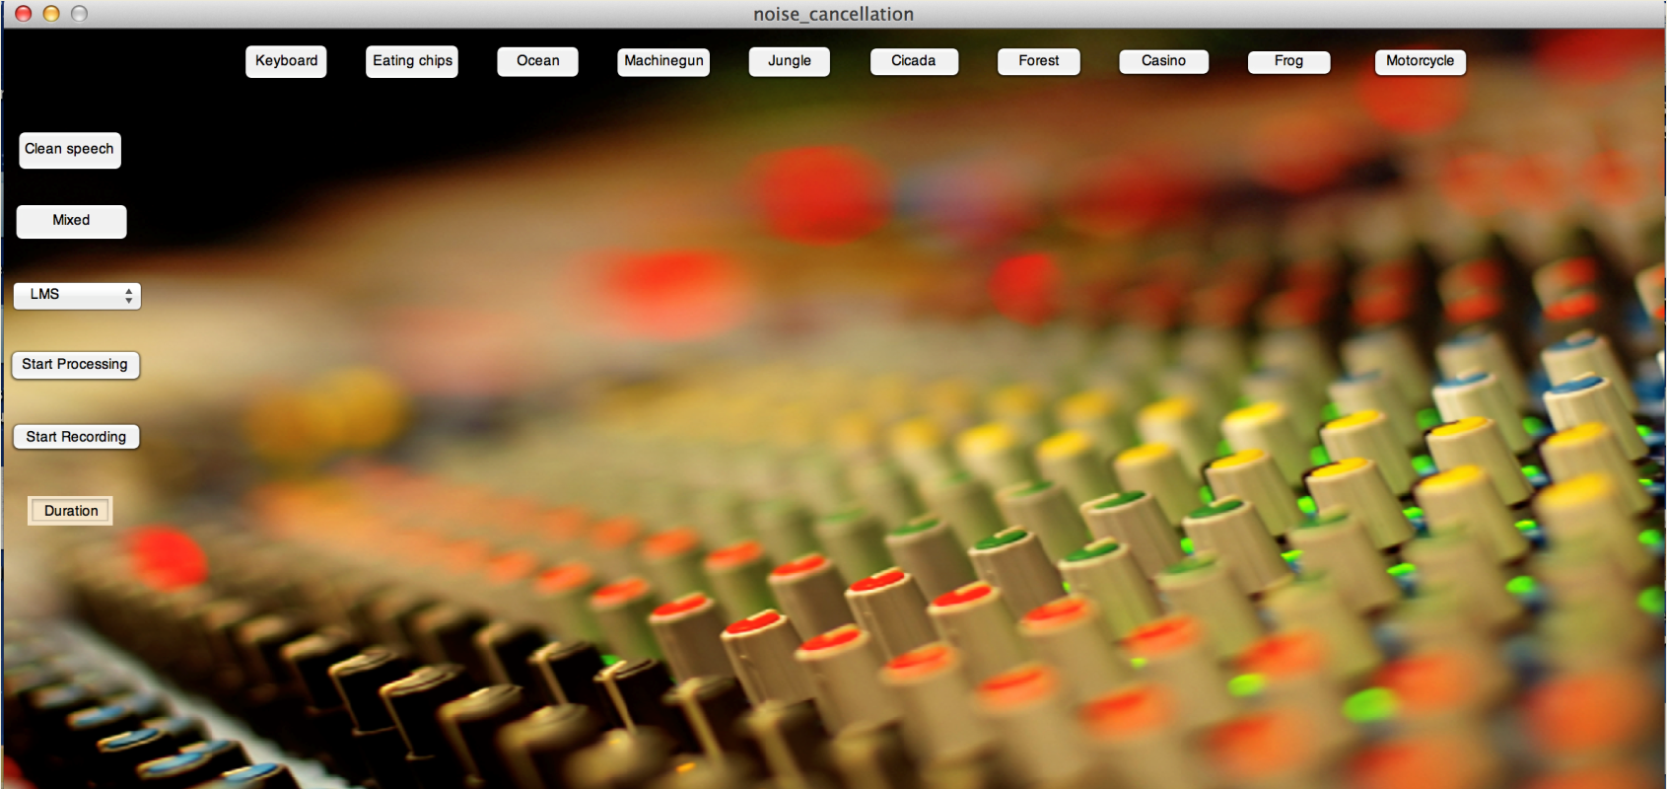
GUI

Slide 26
Limitations, Assumptions and Future work !!
The biggest limitation of our algorithms is the fact that all of them perform the best when there is a prior knowledge of clean speech and the noise input signals. In cellular applications, however only the mixed signal is known and not the individual signals. For applications in headphones, the mixed signal and the clean speech signal is known.
In situations where only mixed signal is known and individual characteristics of the signals isn’t, our algorithms will show a degradation in performance. Amongst all, RLS showed the best performance in such conditions.

Slide 27
Conclusion…
We observed that for a particular noise source and algorithm, as the SNR decreases the perceived audio quality of the restored signal is better. However for comparison of performance of different algorithms for same noise source (“keyboard”), the above tabular data can be referred.
The following performance statistics can be inferred from the data,
RLS> NLMS > LMS > LPC
Further, the performance of each algorithm varies largely with different characteristics of noise input like periodicity, continuity over a period time (i.e. when periods of silence or no sound is negligible), extent of correlation between successive samples etc.
Since all the algorithms are basically adaptive in the sense that they need time to analyze noise characteristics to filter out the noise. Consequently they take a few milliseconds to converge before they remove the effect of noise from the mixed output signal.
The performance of theses algorithms can get severely limited when the noise duration is very short i.e. when the duration of noise is shorter than the convergence time of the algorithm.

Slide 28
Thank You…

