Slide 1
Investigation of Pitch Detection Characteristics from Different Audio Context

Slide 2
Part 1: Introduction

Slide 3
Pitch Detection Characteristics from Different Audio Context
Motivations: Testing pitch detection algorithms using imperfect audio materials
Music note itself can be very complex
A lot of audio material is recorded in imperfect recording conditions, for example, interference from other music instrument in emsemble recording and noise.
Existing source separation algorithms usually provide incomplete separation.
Testing and Evaluation Goals:
Pitch Detection Performance Analysis using Synthesized Notes
Pitch Detection Performance Analysis using Real Musical Notes
Testing Framework:
MIR Toolbox
Pitch detection result 1
Source audio signal
SNR
combined audio signal
(simulate imperfect audio)
MIR Toolbox
Pitch detection result 2
add
distortion
interference note
noise

Slide 4
Part 2: Pitch Detection Performance on Synthesized Notes

Slide 5

Synthesized Notes of Different Complexity
440Hz
440.5227 Hz
MIR Toolbox
Synthesized tone of 440 Hz.
Notes:
PJ_ClASS_TESTTONE_E02_Experiment_1

Slide 6
Synthesized Notes of Different Complexity
440Hz
440.5227 Hz
MIR Toolbox
Synthesized tone of 440 Hz.
Notes:
PJ_ClASS_TESTTONE_E02_Experiment_1

Slide 7
Synthesized Notes of Different Complexity
440Hz
443.3253 Hz
MIR Toolbox
Synthesized tone of 440 Hz. We add in some amplitude modulation and frequency modulation to each sonic partials to add in the complexities.
AM index = 0.5, maximum frequency deviation = 10 Hz at f1
Notes:
PJ_ClASS_TESTTONE_E02_Experiment_2

Slide 8
Synthesized Notes of Different Complexity
440Hz
443.3253 Hz
MIR Toolbox
Synthesized tone of 440 Hz. We add in some amplitude modulation and frequency modulation to each sonic partials to add in the complexities.
AM index = 0.5, maximum frequency deviation = 10 Hz at f1
Notes:
PJ_ClASS_TESTTONE_E02_Experiment_2

Slide 9
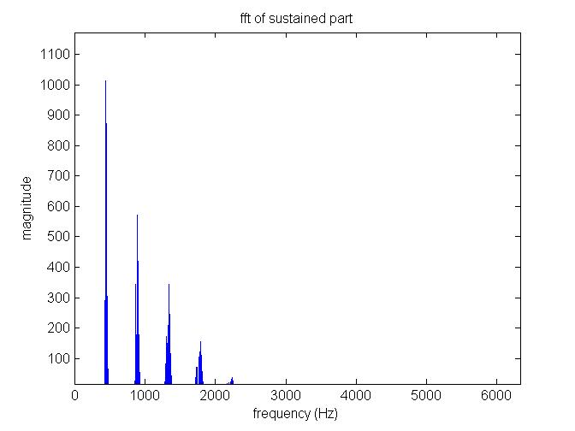
Synthesized Notes of Different Complexity
440Hz
443.3253 Hz
MIR Toolbox
Synthesized tone of 440 Hz. We add in some amplitude modulation and frequency modulation to each sonic partials to add in the complexities.
AM index = 0.5, maximum frequency deviation = 10 Hz at f1
Notes:
PJ_ClASS_TESTTONE_E02_Experiment_2

Slide 10
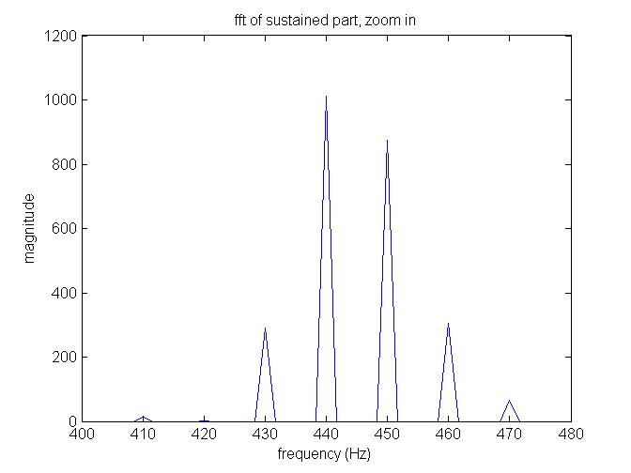
Synthesized Notes of Different Complexity
440Hz
443.3253 Hz
MIR Toolbox
Synthesized tone of 440 Hz. We add in some amplitude modulation and frequency modulation to each sonic partials to add in the complexities.
AM index = 0.5, maximum frequency deviation = 10 Hz at f1
Notes:
PJ_ClASS_TESTTONE_E02_Experiment_2

Slide 11
Synthesized Notes of Different Complexity
440Hz
449.7704 Hz
MIR Toolbox
Synthesized tone of 440 Hz. We add in some amplitude modulation and frequency modulation to each sonic partials to add in the complexities.
AM index = 0.5, maximum frequency deviation = 40 Hz at f1
Notes:
PJ_ClASS_TESTTONE_E02_Experiment_3

Slide 12
Synthesized Notes of Different Complexity
440Hz
449.7704 Hz
MIR Toolbox
Synthesized tone of 440 Hz. We add in some amplitude modulation and frequency modulation to each sonic partials to add in the complexities.
AM index = 0.5, maximum frequency deviation = 40 Hz at f1
Notes:
PJ_ClASS_TESTTONE_E02_Experiment_3

Slide 13
Part 3: Pitch Detection Performance on Real Musical Notes

Slide 14
Interference from Another Music Note
source note
source note f0
596.90 Hz
MIR Toolbox
combined note
combined note f0
1034.02Hz
Wrong
SNR = 3.5dB
MIR Toolbox
add
interference note
interference note f0
1040.83 Hz
MIR Toolbox
Notes:
PJ_CLASS_PITCHER_E03_Experiment_1

Slide 15
Interference from Another Music Note
combined note
combined note f0
1034.02Hz
Wrong
MIR Toolbox
Notes:
PJ_CLASS_PITCHER_E03_Experiment_1

Slide 16
Interference from Another Music Note
combined note
combined note f0
1034.02Hz
Wrong
MIR Toolbox
Notes:
PJ_CLASS_PITCHER_E03_Experiment_1

Slide 17
Interference from Another Music Note
source note
source note f0
596.90 Hz
MIR Toolbox
combined note
combined note f0
596.47 Hz
Right
SNR = 8.61 dB
MIR Toolbox
add
interference note
interference note f0
1040.83 Hz
MIR Toolbox
Notes:
PJ_CLASS_PITCHER_E03_Experiment_2

Slide 18
Interference from Another Music Note
combined note
combined note f0
596.47 Hz
Right
MIR Toolbox
Notes:
PJ_CLASS_PITCHER_E03_Experiment_2

Slide 19
Interference from Another Music Note
combined note
combined note f0
596.47 Hz
Right
MIR Toolbox
Notes:
PJ_CLASS_PITCHER_E03_Experiment_2

Slide 20
Interference from Another Music Note
Notes:
PJ_CLASS_PITCHER_E03_Experiment_2_morepoints

Slide 21
Interference from Noise
source note
source note f0
596.90 Hz
MIR Toolbox
combined note f0
596.65Hz
Right
SNR = 3.29 dB
MIR Toolbox
add
noise
combined note
Notes:
PJ_CLASS_PITCHER_E03_Experiment_3

Slide 22
Interference from Noise
combined note f0
596.76Hz
Right
MIR Toolbox
combined note
Notes:
PJ_CLASS_PITCHER_E03_Experiment_3

Slide 23
Interference from Noise
combined note f0
596.76Hz
Right
MIR Toolbox
combined note
Notes:
PJ_CLASS_PITCHER_E03_Experiment_3

Slide 24
Interference from Noise
source note
source note f0
596.90 Hz
MIR Toolbox
combined note f0
600.06Hz
Right
SNR = -2.63 dB
MIR Toolbox
add
noise
combined note
Notes:
PJ_CLASS_PITCHER_E03_Experiment_4

Slide 25
Interference from Noise
combined note
combined note f0
600.06Hz
Right
MIR Toolbox
Notes:
PJ_CLASS_PITCHER_E03_Experiment_4

Slide 26
Interference from Noise
combined note
combined note f0
600.06Hz
Right
MIR Toolbox
Notes:
PJ_CLASS_PITCHER_E03_Experiment_4

Slide 27
Interference from Noise
Notes:
PJ_CLASS_PITCHER_E03_Experiment_4_morepoint

Slide 28
Conclusions

Slide 29
Conclusions
We implemented a framework to validate the performance of pitch detection algorithms at different audio qualities.
We tested the performance of MIR toolbox pitch detection algorithms using both synthesized music notes and real music notes.
Three factors that affects pitch detection performance are investigated. These factors include the complexity of the music note, interference from concurring music note and noise.

Slide 30
QA

Slide 31
Thank you!

