Slide 1
MIDI Harmonizer
Gavin Baker

Slide 2
Fundamental Principles
Classical Vocoder
LPC analysis

Slide 3
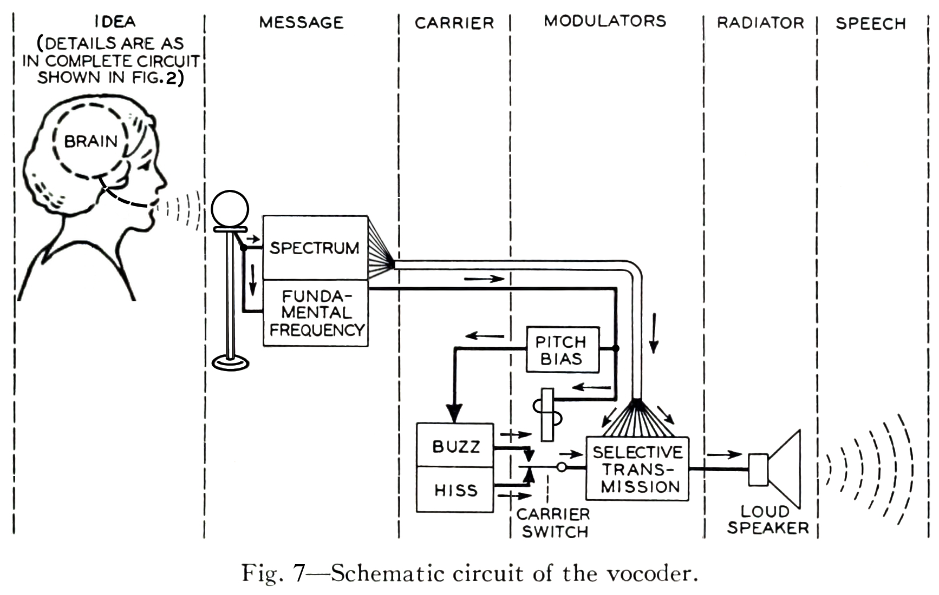
Vocoder

Slide 4
Implementation Basics
PyGame
PyAudio
LibRosa

Slide 5
DSP Overview
LPC Analysis creates a filter based on input signal (my voice)
Voice can be pitch shifted first to create different filters
We can impose that filter on any signal
Create sawtooth wave based synthesizer
All harmonics present
Superimpose LPC filter onto synthesized sound to blend the two together

Slide 6
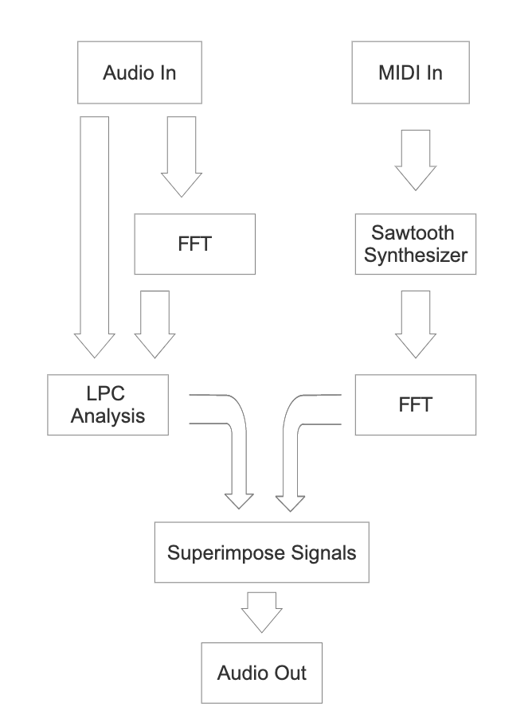
Block Diagram

Slide 7
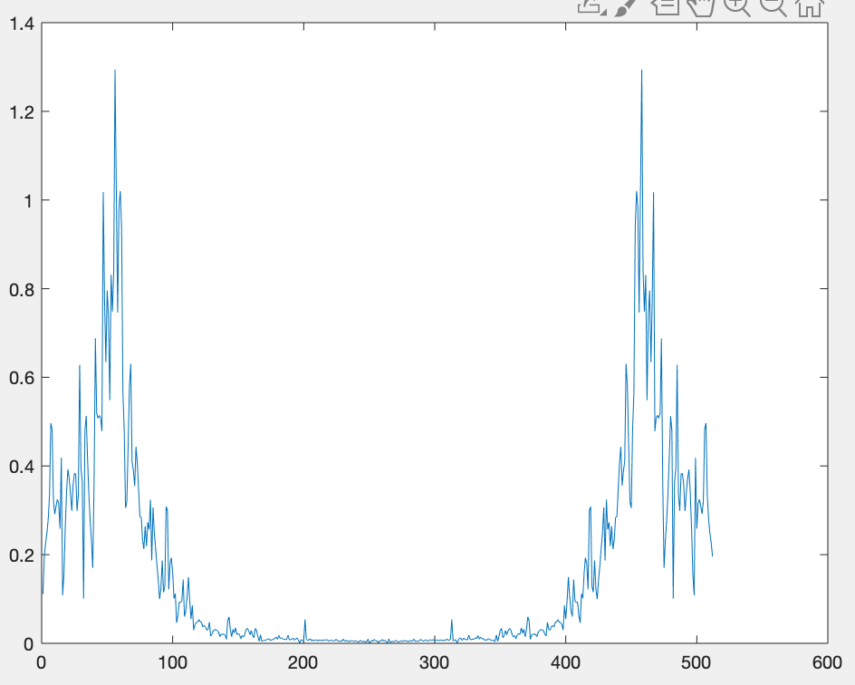
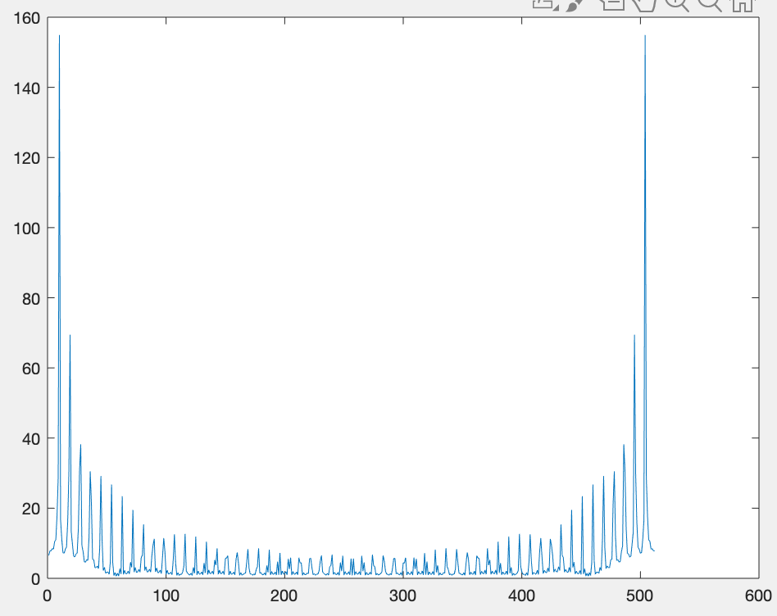
Input Signals
Filter
Sawtooth In

Slide 8
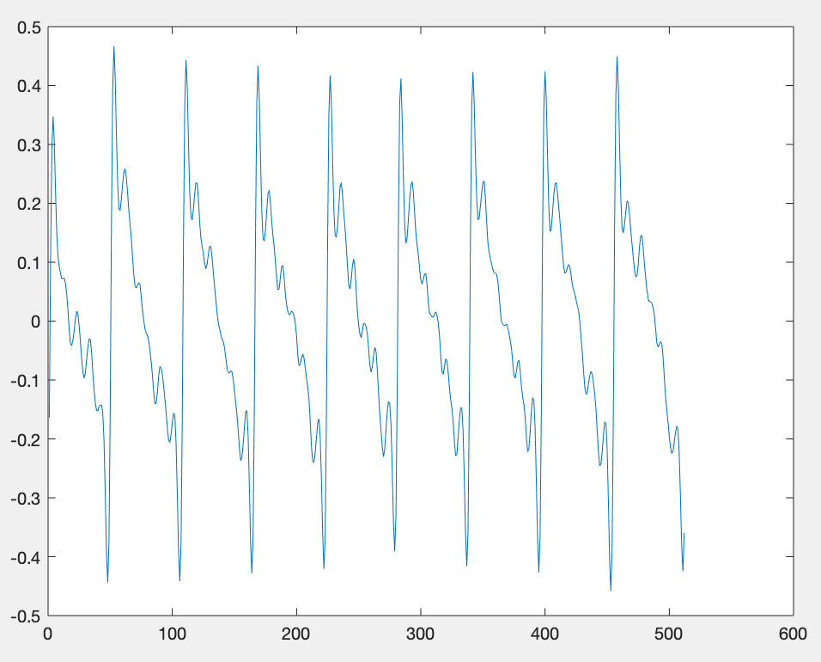
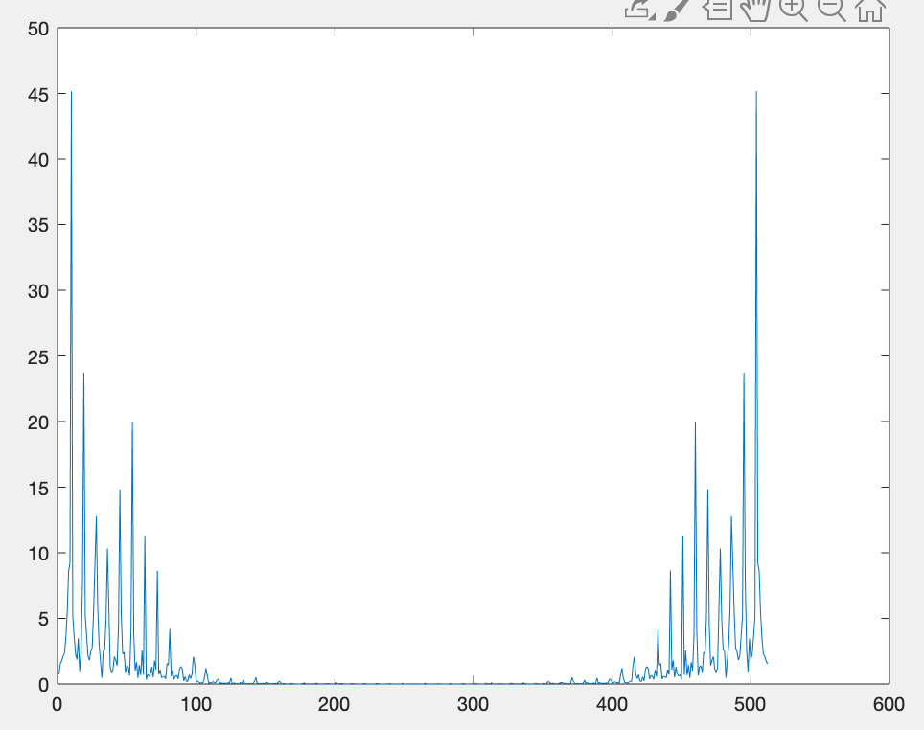
Output Signals
Time Domain Signal
FT of Output Signal

Slide 9
Further Work
Reduce I/O Latency
Improve Synthesizer
Speed and sound clarity
Improve voice quality by better pitch shifting

Slide 10
Questions?

