Slide 1
Pitch Identification and Modification
James McCarthy and Matt Kyong

Slide 2
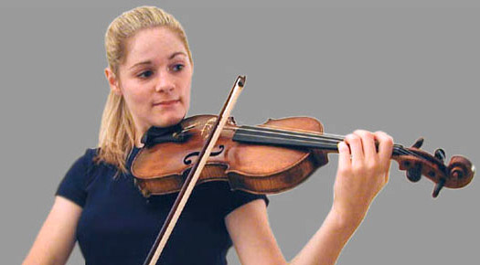
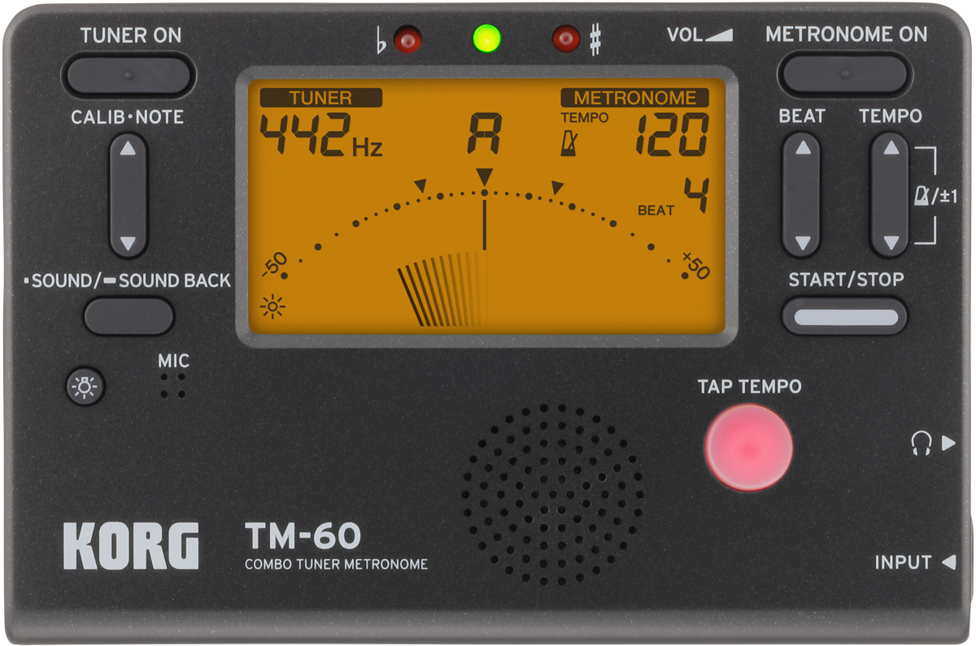
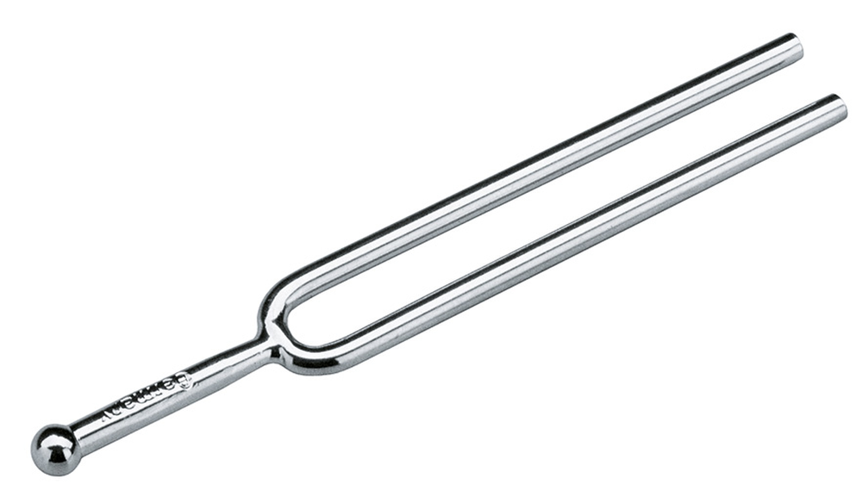
Background
Who is this product made for?
People looking for tuning methods
Instrumentalists working on intonation
People working on perfect pitch/relative pitch

Slide 3
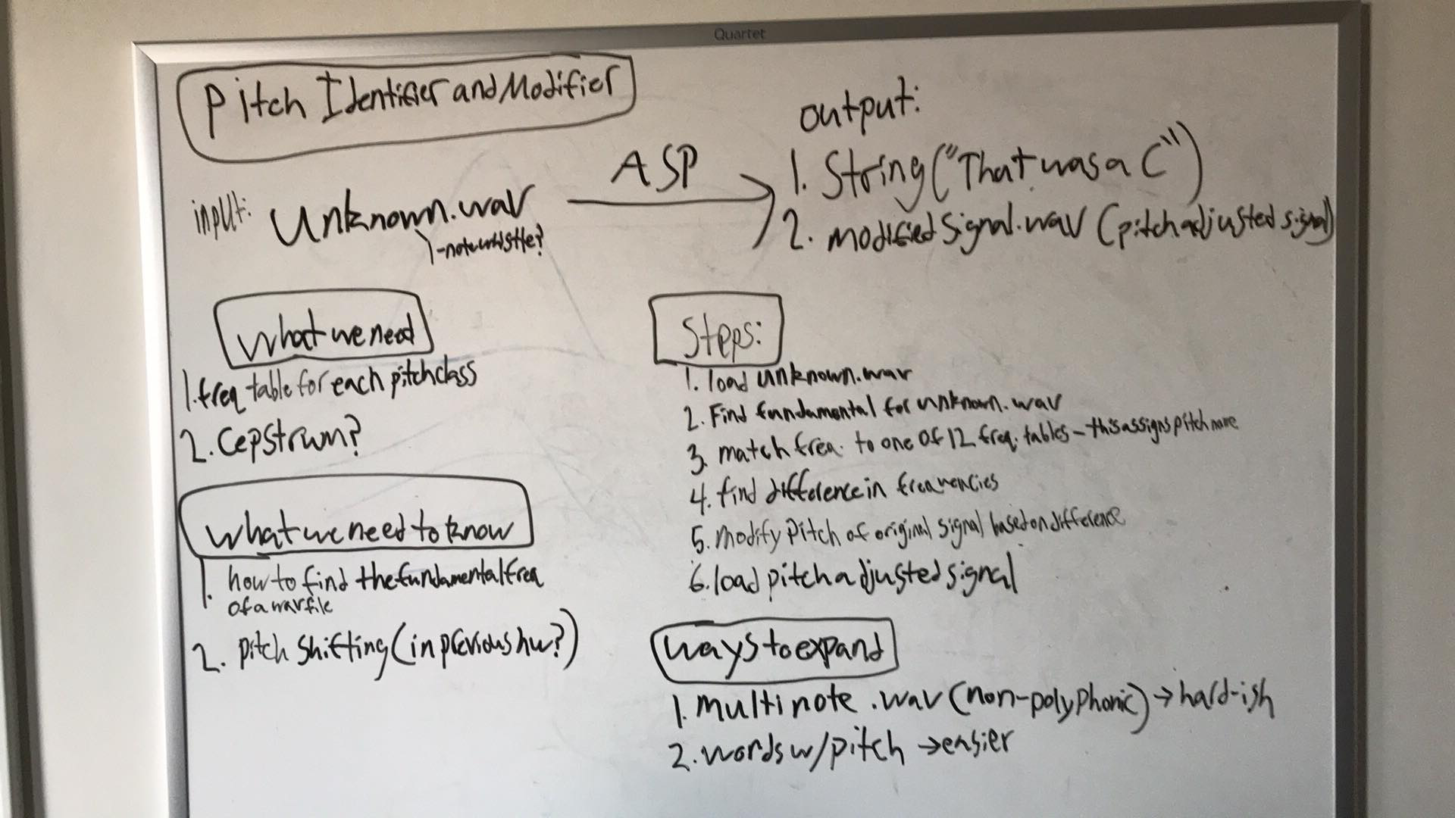
Goals
Record user and identify pitch
Modify pitch and play back the corrected pitch

Slide 4
Pitch Identification
Main Goal:
Receive audio data
Retrieve its fundamental frequency
Score it against a frequency table
What’s needed:
Creation of an audiorecorder object
Find a way to get the fundamental frequency of the recording
Create a frequency table to judge the recorded frequency

Slide 5
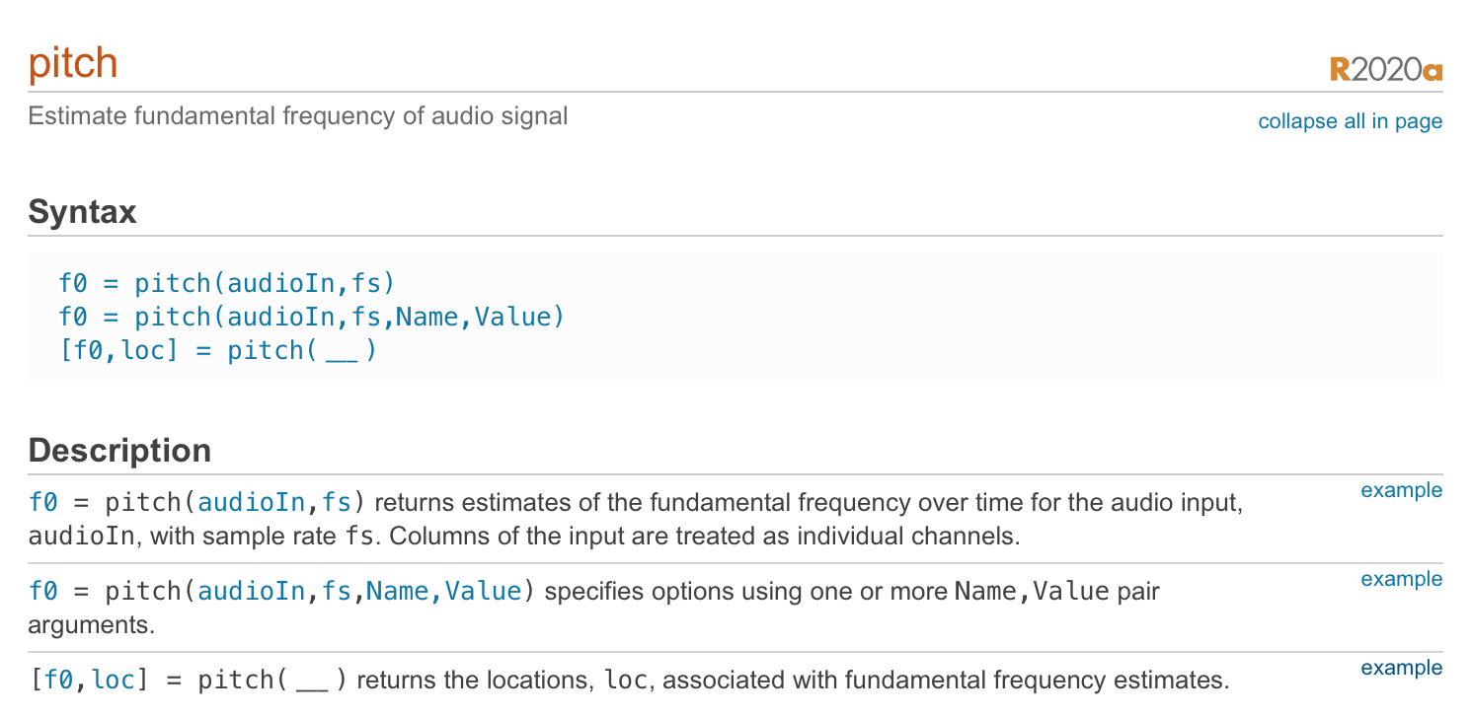
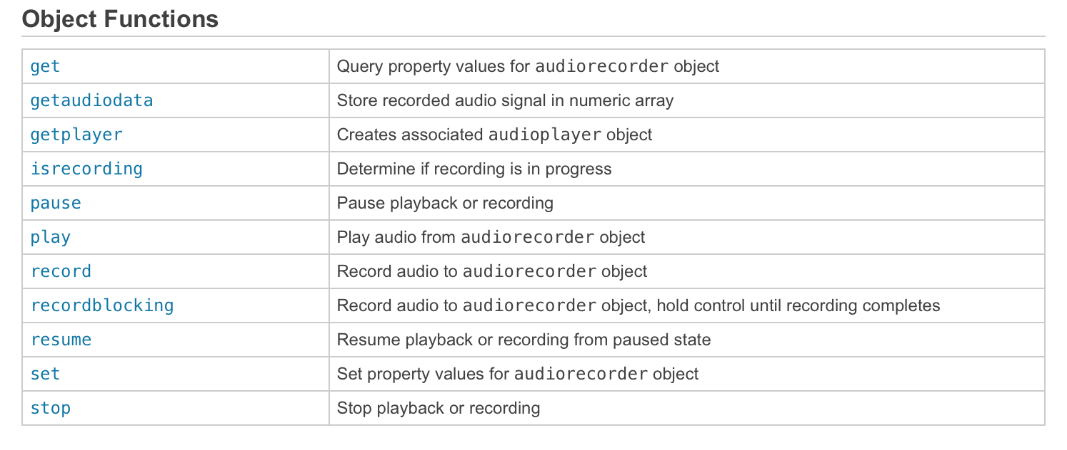
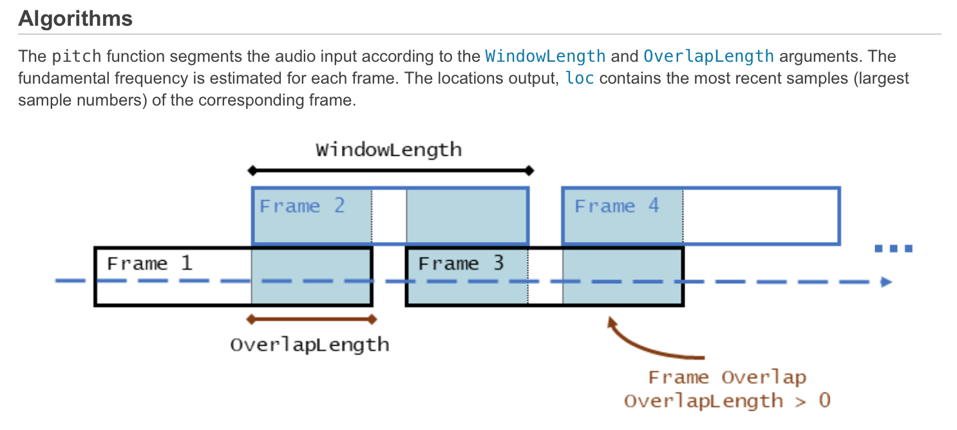
Pitch Identification

Slide 6
Pitch Identification
Simplified Block Diagram:
User
Audiorecorder
Limiter
Pitch
getaudiodata
FreqTable
Pitch Name!

Slide 7
Pitch Modification

Slide 8
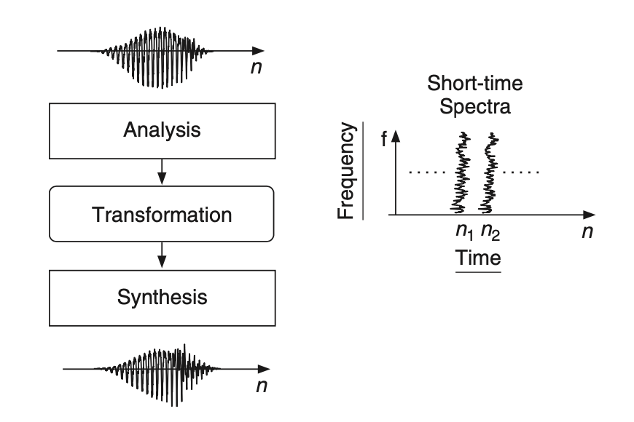
Pitch Modification
Main Goal:
Pitch correct the input signal while maintaining its timing
Phase Vocoder Algorithm
Notes:
We want the user to be able to hear themself sing the note perfectly in tune.
We want only sonic difference for pitch corrected signal to be the pitch difference and so,
We need a way to independently change pitch and time

Slide 9
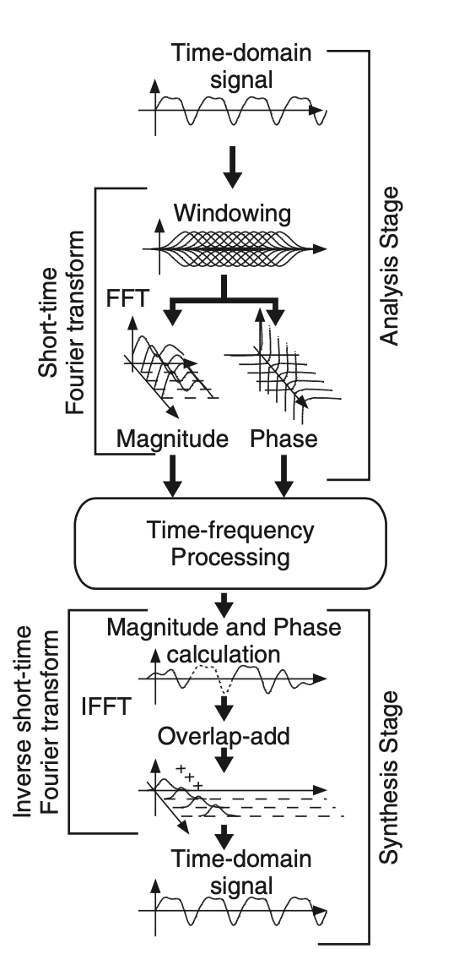
Phase Vocoder
Basic phase vocoder algorithm:
Resample original signal for pitch change
Time Domain -> Frequency Domain
Linear Interpolation for speed change
Notes:
Phase vocoder is an example of time-frequency processing
Process is split into 3 stages: analysis stage, transformation, and synthesis
Phase vocoder from homework: 3 steps:
Resample for pitch change
Time domain-> freq domain with windowing and stft
Linear interpolation for speed change
For the purposes of this project, pitch change is based on ratio between identified pitch and desired pitch
Speed change is 1/pitch change to get original signal length
Drawbacks: artifacts and distortions, throws off pitch ID

Slide 10
Basic phase vocoder demo

Slide 11
Improvements on basic phase vocoder
Artifacting and noise in basic implementation
Linear interpolation vs. hop size scaling
Phase increments scaled by hop size
Issues with this improved algorithm
Notes:
Basic phase vocoder algorithm has issues with artifacting and noise
Instead of linearly interpolating FFT frames, to time stretch the signal, use different hop sizes for STFT and iSTFT
The phase increments are also scaled using based on the analysis and synthesis hop sizes
This got rid of essentially all the noise and artifacts!
Issues with this algorithm, while there is mostly no audible artifacting/distortions, it is not possible to get a perfect time stretch to the original length;
The analysis/synthesis hop size lengths are calculated based on the 1/beta ratio, but must be scaled down to accommodate the window length
Rounding error means that the original signal length is not perfectly achieved (with linear interpolation the exact number of frames can be interpolated)
Due to the small amount of time change required to tune a note, it is not a huge issue

Slide 12
New pitch modification demo

Slide 13
Conclusions
Algorithm Improvements
Multiple note identification
Tuning multiple notes
Better method for getting rid of background noise - basic limiter is used currently
Pitch identification with polyphony

