Slide 1
Automatic music transcription for polyphonic music
Qiaoyu Yang

Slide 2
Benetos, Dixon, Duan, Ewert (2019)
Non-negative matrix factorization (NMF)
Neural network

Slide 3
Non-negative matrix factorization
A matrix X of dimension m x n
Find W of dimension m x k and H of dimension k x n, such that X = W x H
All the three matrix have only non-negative elements.

Slide 4
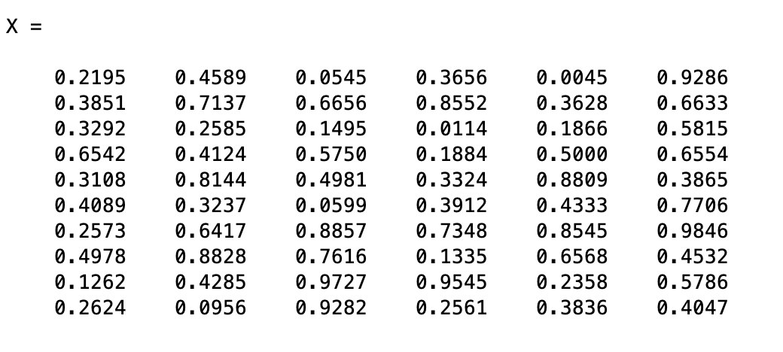
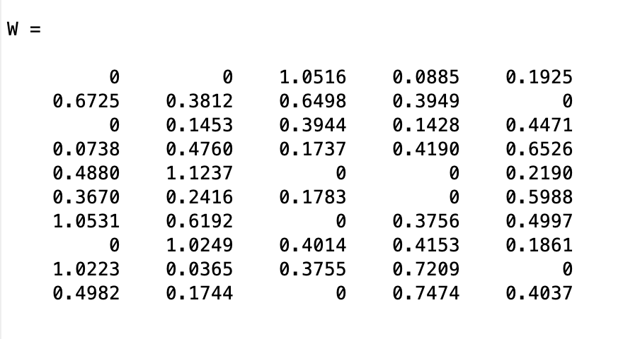
X: 10 x 6
W: 10 x 5
H: 5 x 6

Slide 5
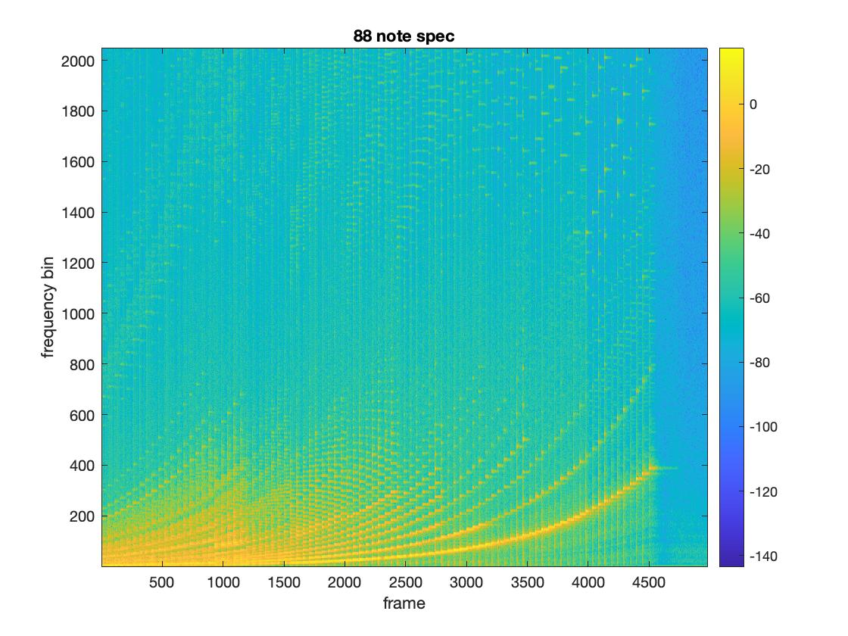
Spectrogram as a matrix

Slide 6
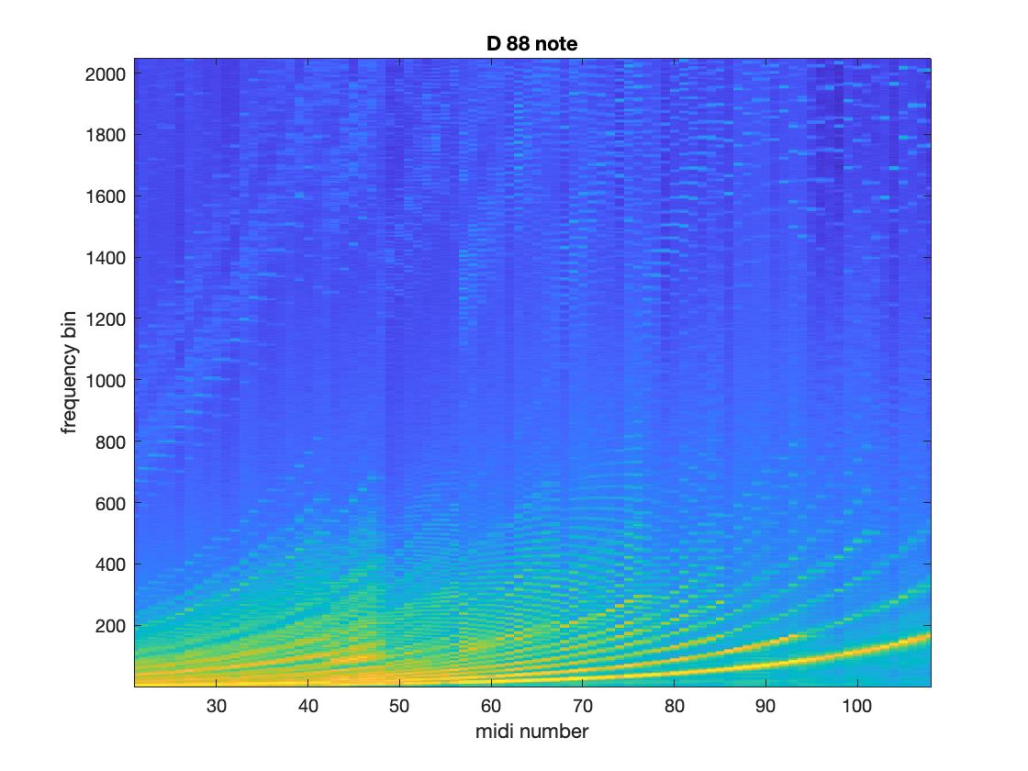
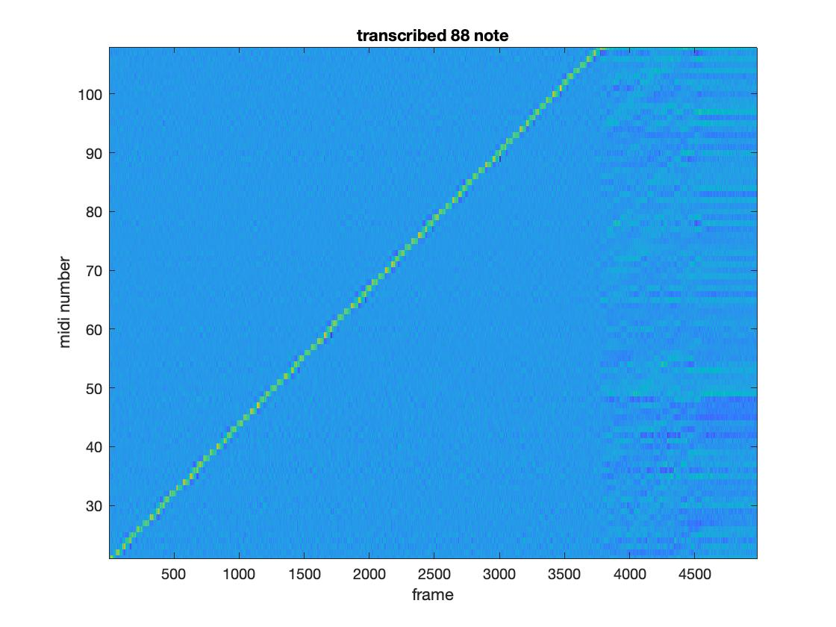
W = spectral template (harmonic information)
H = activation matrix (note information)

Slide 7
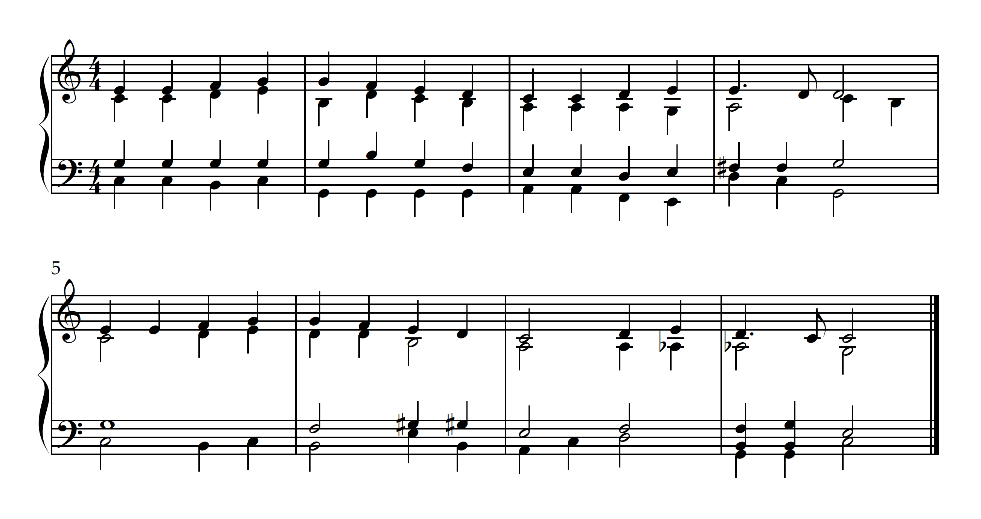

Slide 8
Step 1 Get the spectrogram
Apply STFT to the audio file
M = 1024
Hamming window
hop = 512
t = 4
N = 4096 (2049 non-negative)

Slide 9
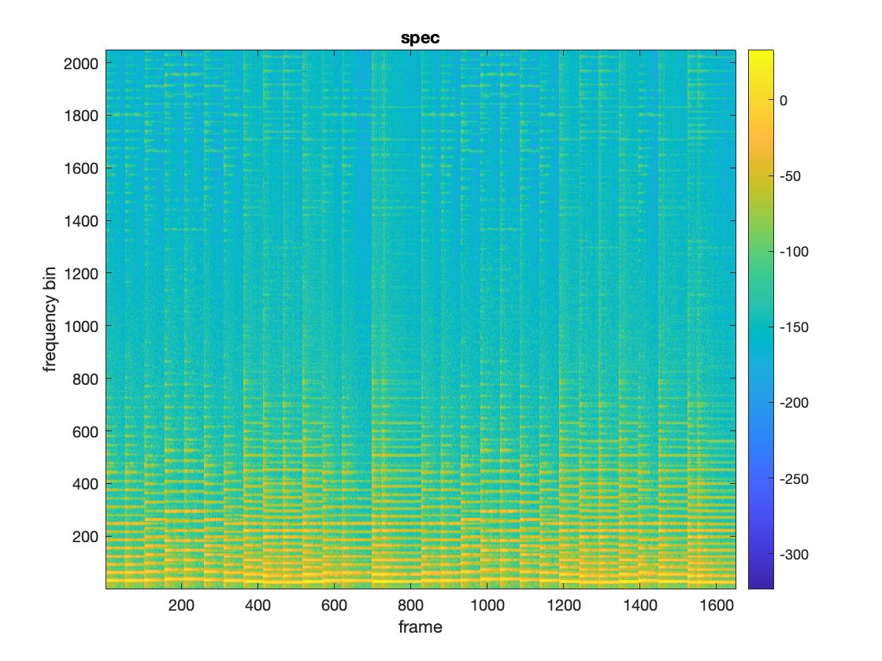

Slide 10
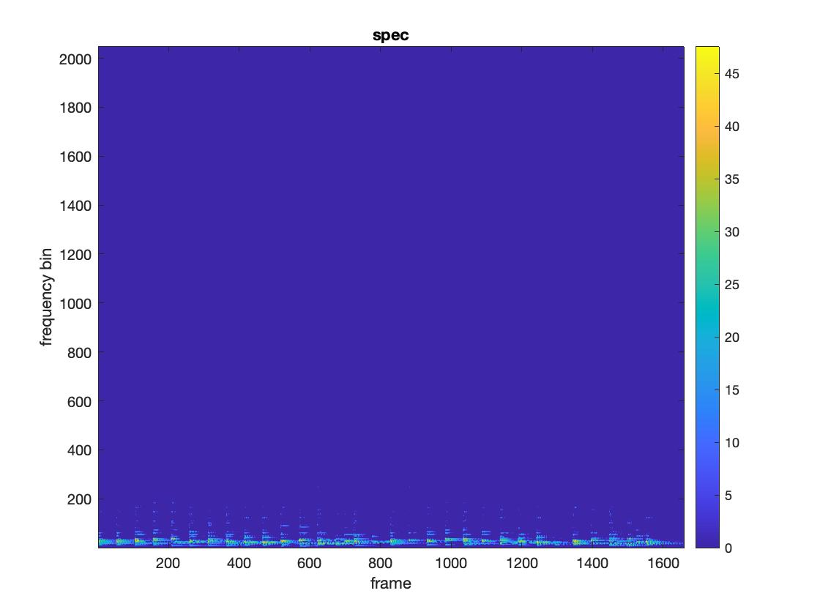

Slide 11
Step 2 NMF
nnmf(matrix, k)
X: 2049 x 1658
W: 2049 x 36
H: 36 x 1658

Slide 12
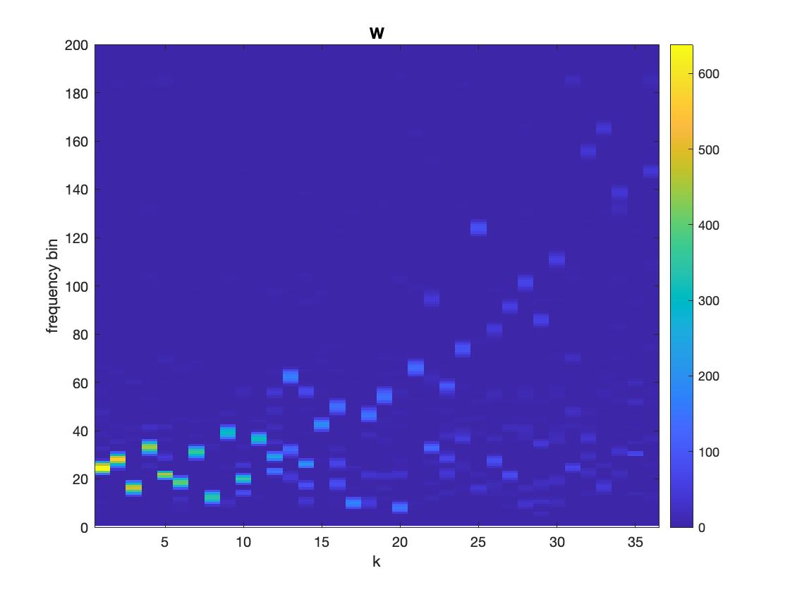
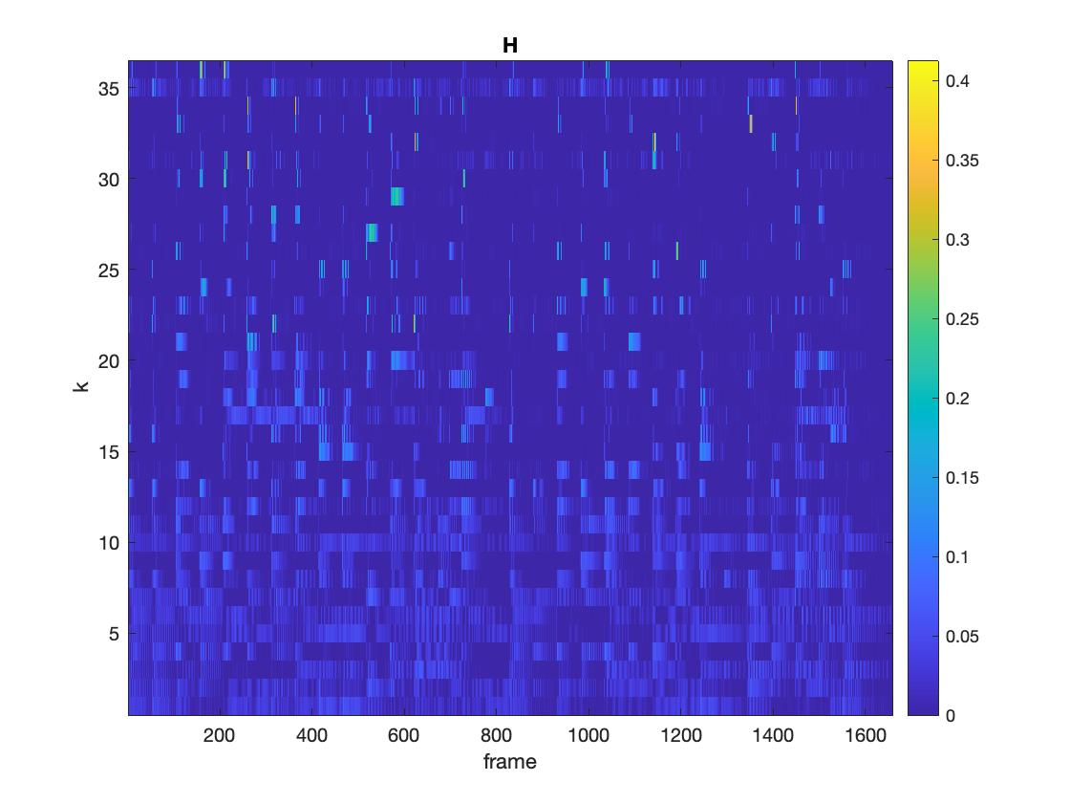

Slide 13
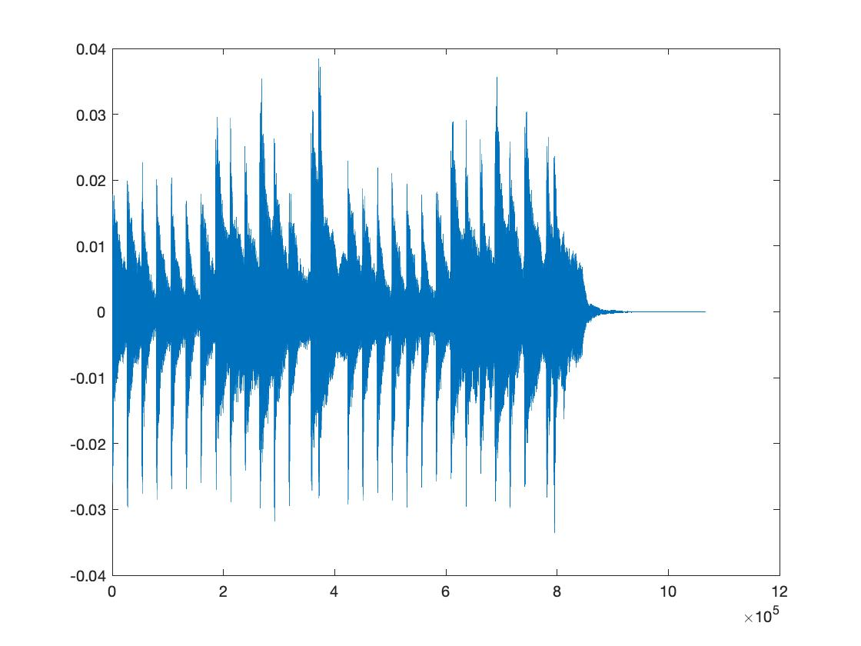
Step 3 Onset detection
Find the places with large energy

Slide 14
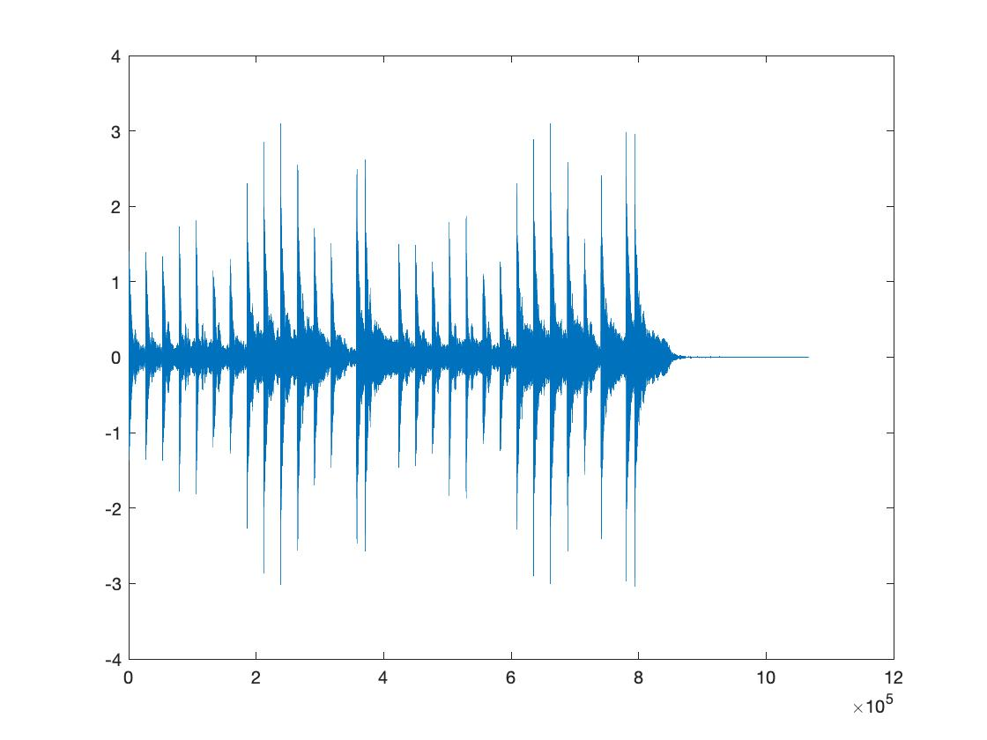
Preprocessing
Apply a bandpass filter within frequency band [4000, 4186]
Extend the dynamic range by 1000

Slide 15
Find the sudden increase in energy
An onset occurs in the first frame of a window,
Window size = 3 frames
Energy threshold = 1
the first, if any, in every 20 frames

Slide 16
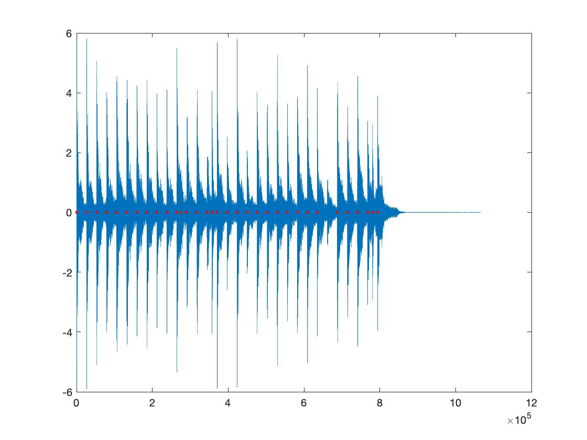

Slide 17
Step 4 Pitch detection
1. In the W matrix, find the frequency that corresponds to each k

Slide 18
Find the frequency that fit harmonics
1. find the spectral peaks
2. For each f in the peaks, calculate the error function $\sum_{pεpeaks}{{(E(f)−E(p))}^{2}}$
3. Choose the frequency that minimizes the error.

Slide 19
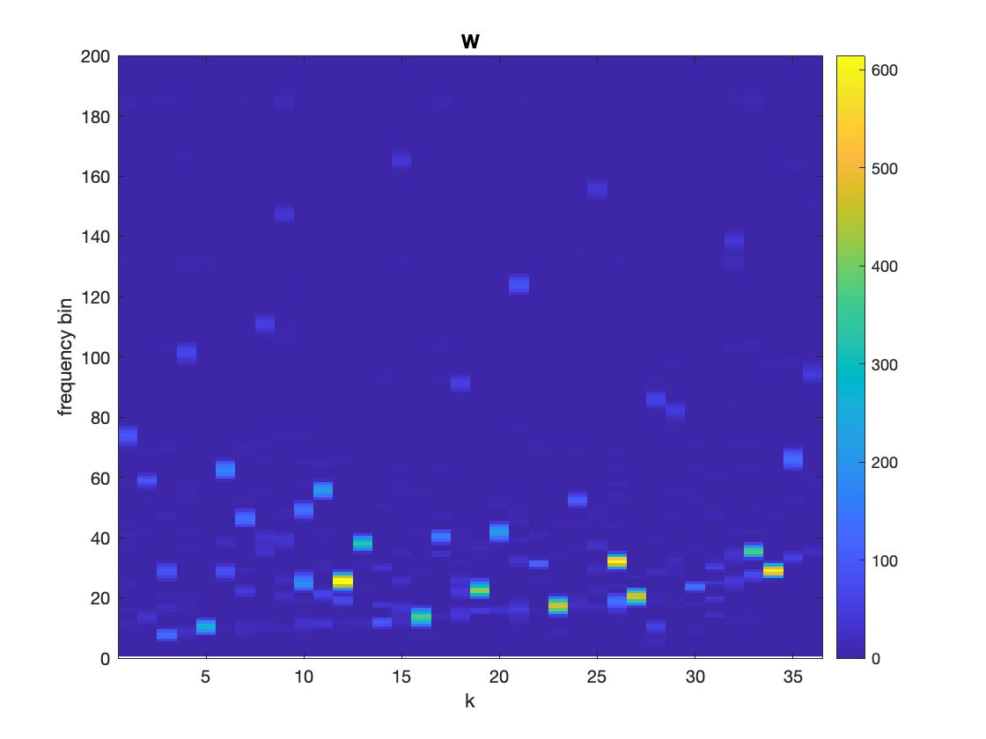
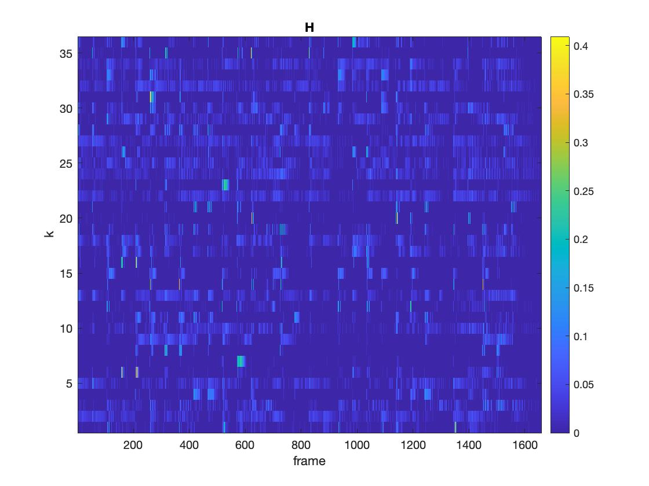
Rearrange the matrices with increasing f order

Slide 20
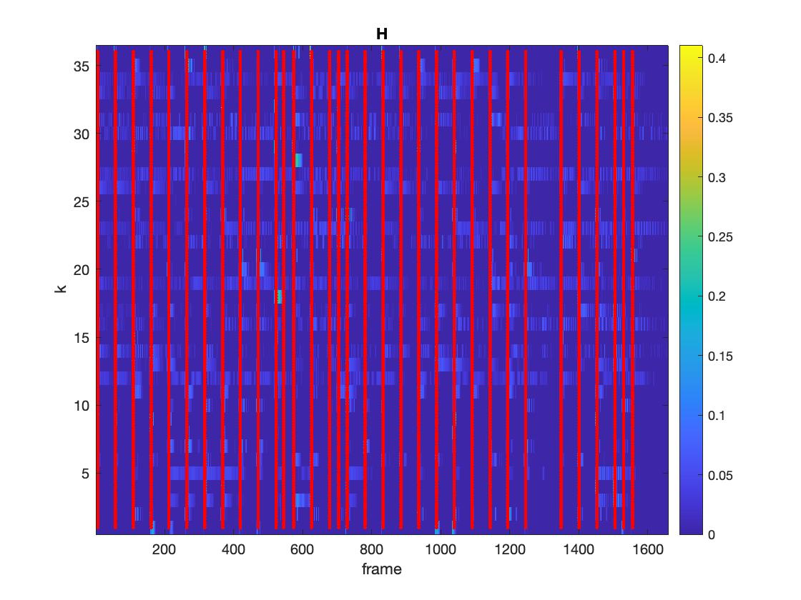
Use onsets to filter the notes

Slide 21
Postprocessing
1. Reduce the noise by choosing regions with values greater than 0.05
2. offset = onset + inter onset interval
3. Find the midi numbers with the closest frequency

Slide 22
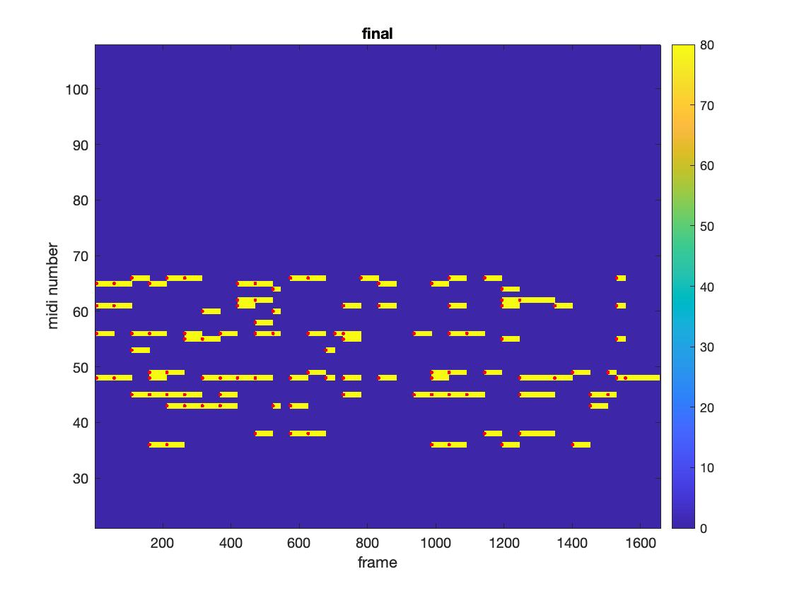
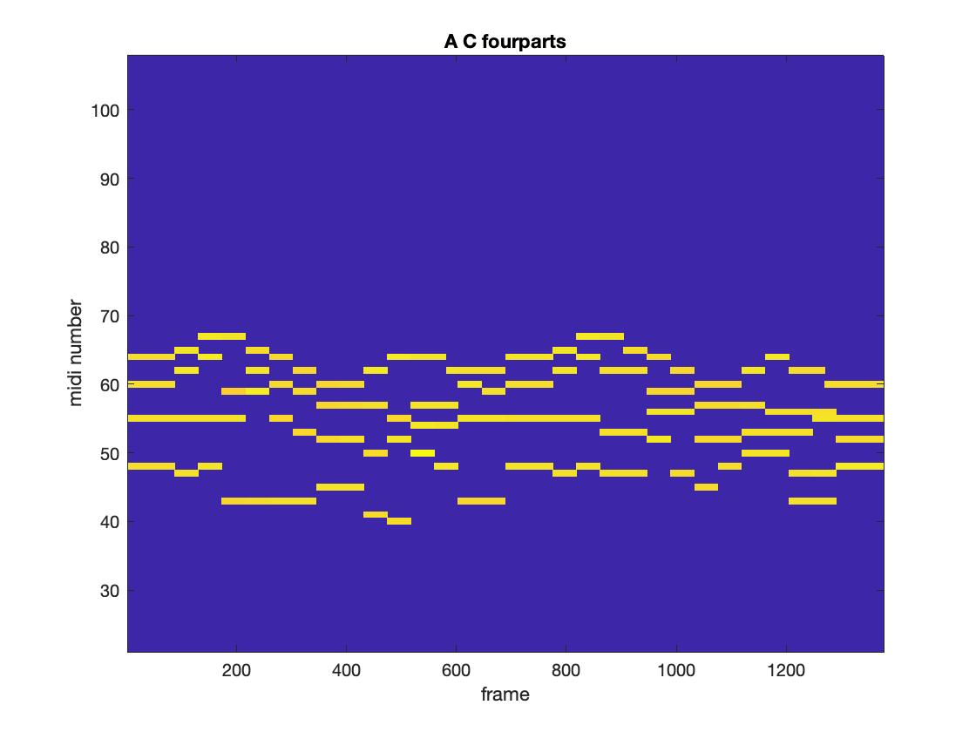

Slide 23
Going forward
Improve frequency detection
Improve note extraction
Apply to music with multiple instruments
Generate the score

