Slide 1
Plate Reverb Simulation

Slide 2
Outline
Introduction (1m)
Modeling the Plate (2m)
Implementation (2m)
Demonstration (3m)
Future Work (1m)
Conclusion (1m)

Slide 3
Introduction
Plate reverbs have been popular in music since the 1950s
Typical emulations rely on finite difference equations or delay lines
Modal approach benefits:
Frequency dependent losses
Natural parallel structure
Dimensionality reduction
Faster and cheaper simulations
Quality/Speed tradeoff

Slide 4
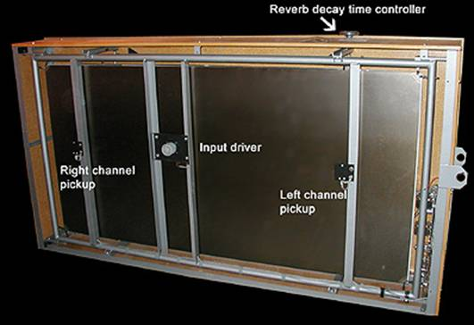
Modeling the Plate
Properties of plate: material and constants
Dimensions (length, width, thickness)
Density, tension
Loss parameter (frequency-dependent decay)
Young’s modulus and Poisson’s ratio to model flexural rigidity
Transducer and pickup locations
Modes and eigenfrequencies to calculate displacement of the plate
Decay parameters calculated from properties mentioned above applied to signal
https://www2.ph.ed.ac.uk/~sbilbao/platerevpage.htm

Slide 5
Implementation

Slide 6
Audio Parameters/GUI

Slide 7
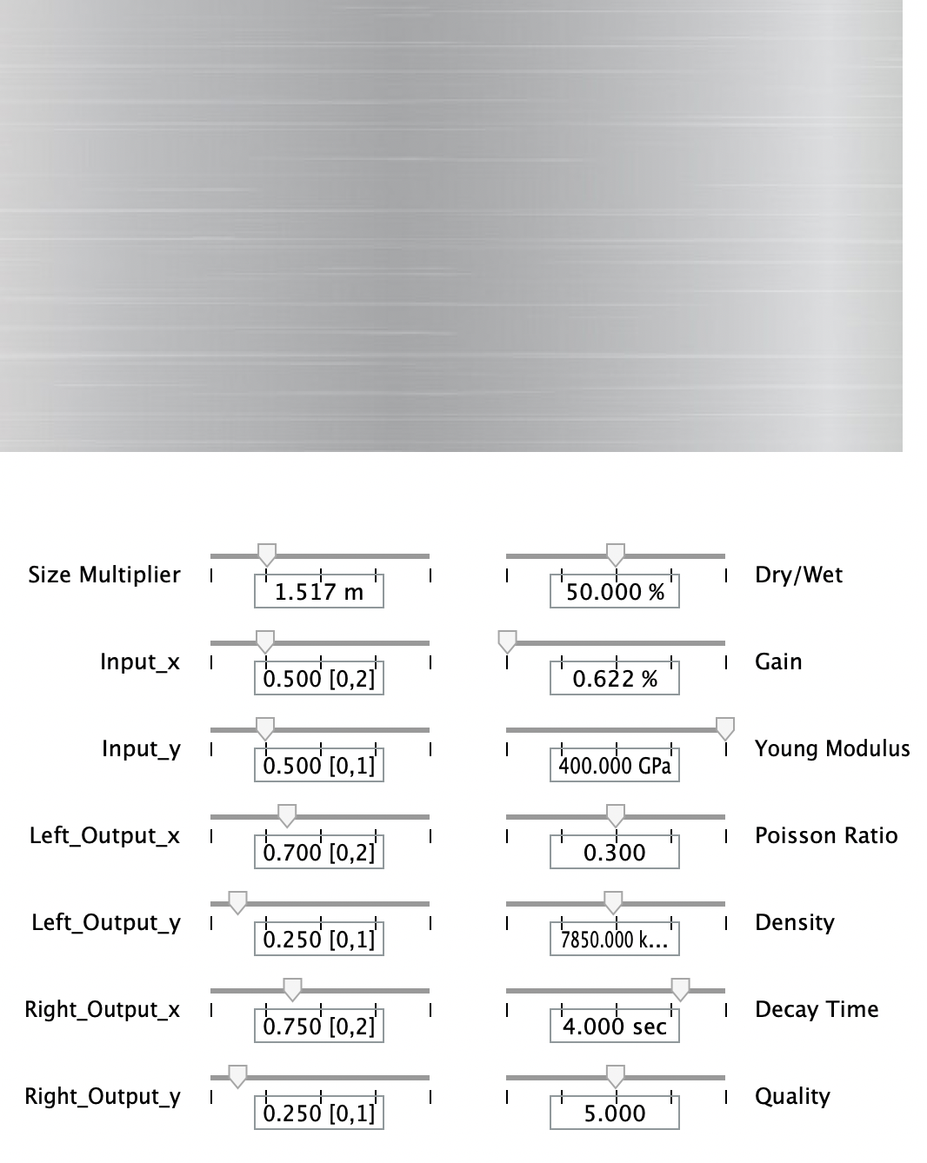
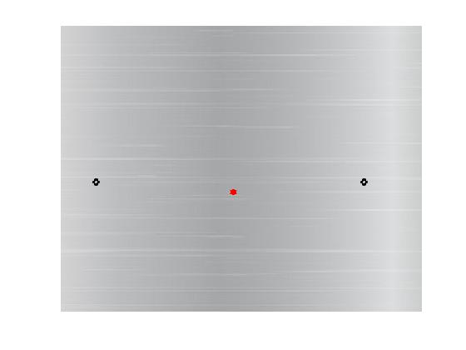
Audio Parameters/GUI
Default in/out pickup locations on the plate

Slide 8
Demonstration
Erik Satie: Trois Gymnopédies
Bernard "Pretty" Purdie: The Legendary Purdie Shuffle
Notes:
Satie link: https://drive.google.com/file/d/1Z-5iZ7lsDPwU99bxXtFiPdWiykDWgAqa/view Purdie link: https://drive.google.com/file/d/1EyGAH-P4NGcqeepxE1qMZo9_lujm03Qp/view

Slide 9
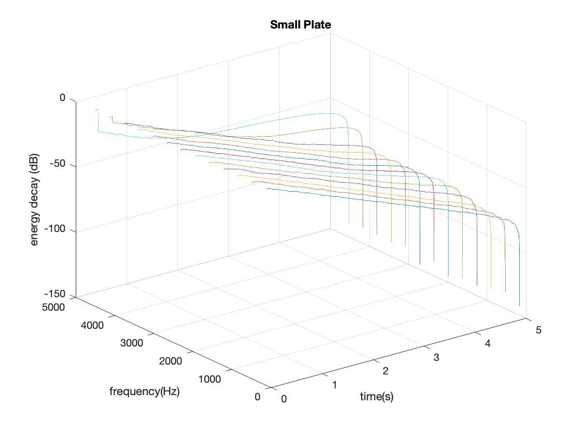
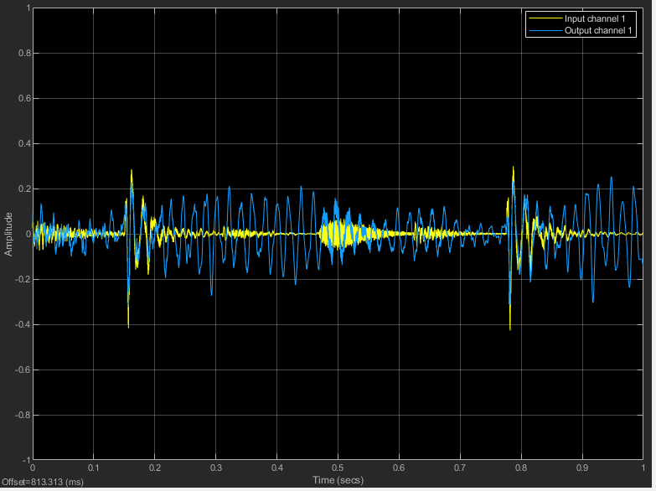
Demonstration

Slide 10
Future Work
Manual placement of actuators/pick-ups
Automation of moving actuators/pick-ups
Develop understanding of numerical solutions to modal analysis
Stability condition
Frequency-dependent decay
Plate size effect on reverberation color

Slide 11
Conclusion
Modal synthesis for plate reverb emulations offer a quality and computationally efficient implementation

Slide 12
References
[1] Silvin Willemsen (2020). Extended Virtual Analog Plate Reverb Plugin, MATLAB Central File Exchange. Retrieved April 21, 2020.
[2] Ducceschi, Michele & Webb, Craig. (2016). Plate reverberation: Towards the development of a real-time physical model for the working musician.

Slide 13
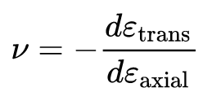
Model Equations
Kirchoff-Love model for plate displacement
Young’s Modulus
Poisson’s Ratio
Eqn here

