Slide 1
ECE 427 Project Presentation
Tianruo Sun
Zimo Cheng
Lihao Yang

Slide 2
Project Description
Watermarking is a technique for embedding additional data along with audio signal so that it will not effect its perceptual quality of an audio signal.
Host signal: audio
Watermark: data sequence

Slide 3
Requirements of watermarking
Inaudibility. The signal to noise ratio of the watermarked signal to the original signal should be maintained greater than 20 dB. Also, we should make sure that the modified signal not perceivable by human ear. [1]
Robustness. Watermark should be robust against common signal processing attacks such as lossy compression, linear filtering, resampling, etc. [1]
Capacity. The efficient watermarking technique should be able to carry more information but should not degrade the quality of the audio signal. [1]
Robustness
Inaudibility
Capacity

Slide 4
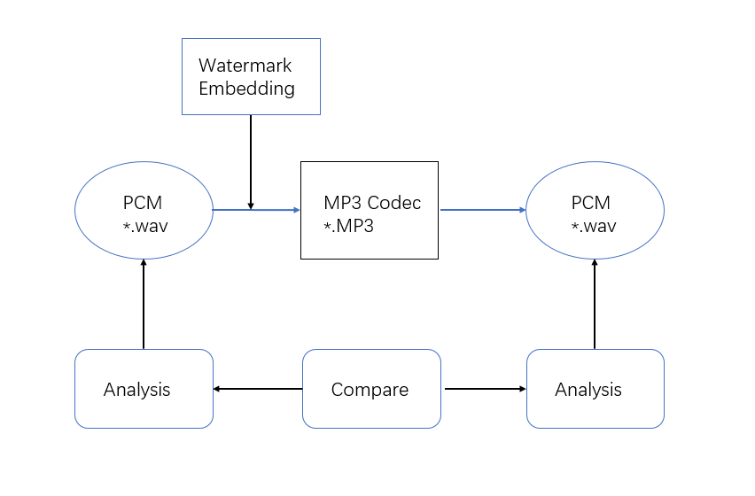
Flow Diagram

Slide 5
MP3 Specification
MP3 (formally MPEG-1 Audio Layer III or MPEG-2 Audio Layer III) is a compressed coding format for audio signal.
Validation for robustness (compressed).

Slide 6
MP3 basic techniques
compressed domain
Embed watermarks to PCM-data operate with all audio formats (not sure to survive the coding/decoding procedure, time consuming)
Sanford et al. and MP3Stego
Auxiliary information is embedded as a watermark into the host signal by a lossy compression technique
MP3Stego hides information in MP3 files during the compression process (compress, encrypted, and then hidden in the MP3 bit stream)
Use or not of the original signal for watermark detection
Not to use the original signal because it results in storage waste and adds danger of its usage by malicious users.
Not immunized against inversion attacks by third parties. [2]

Slide 7
Different algorithms for watermarking
Time domain algorithms:
Least Significant Bit Coding
Echo Hiding
Frequency domain algorithms:
Phase coding
Spread spectrum

Slide 8
Least Significant Bit Coding
Substitution of the LSB of the cover audio with the bit pattern from the watermark signal.
ASCII code for letter “y” is 121.
Binary representation of decimal 121:
0 | 1 | 1 | 1 | 1 | 0 | 0 | 0

Slide 9
Phase Coding
Replacing the phase of initial audio segment with a reference phase which represents the embedded information. [3]
$φ_{data}=\frac{π}{2}$for binary message 0
$φ_{data}=−\frac{π}{2}$ for binary message 1
$\left[\begin{aligned}φ_{out1}=φ_{data1}+∆φ_{1} \\ … \\ φ_{outn}=φ_{datan}+∆φ_{n} \\ … \\ φ_{outK}=φ_{datak}+∆φ_{k}\end{aligned}\right]$

Slide 10
LSB and Phase Coding Results
 | Bit Error Rate | STOI
LSB Encoded WAV | 0 % | 0.999
LSB After Low Pass Filter | 49.1 % | 0.989
LSB After MP3 Codec | 51.8 % | 0.998
Phase Coding Encoded WAV | 0 % | 0.999
Phase Coding After Low pass Filter | 0.572 % | 0.988
Phase Coding After MP3 Codec | 46.8 % | 0.996

Slide 11
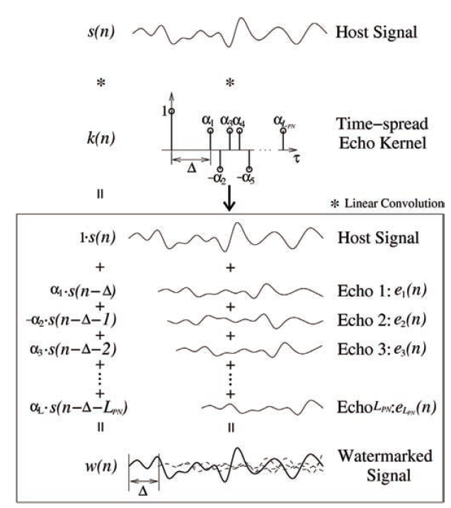
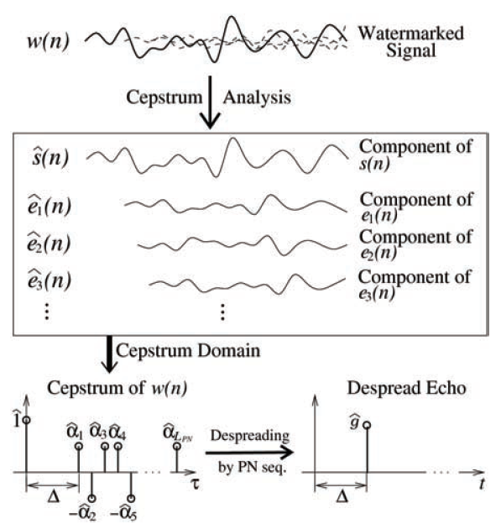
Echo Hiding [4]

Slide 12
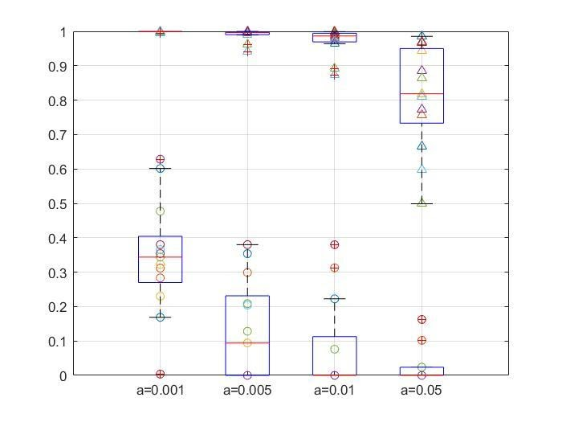
Echo Hiding Results
Audio Quality
Audio Quality
Error Rate
Error Rate
Before MP3 Codec
After MP3 Codec

Slide 13
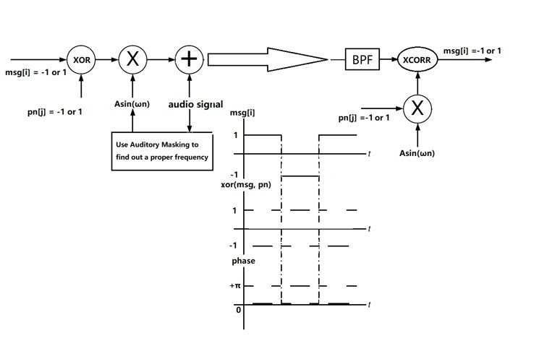
Spread Spectrum [5]
Spread
Despread

Slide 14
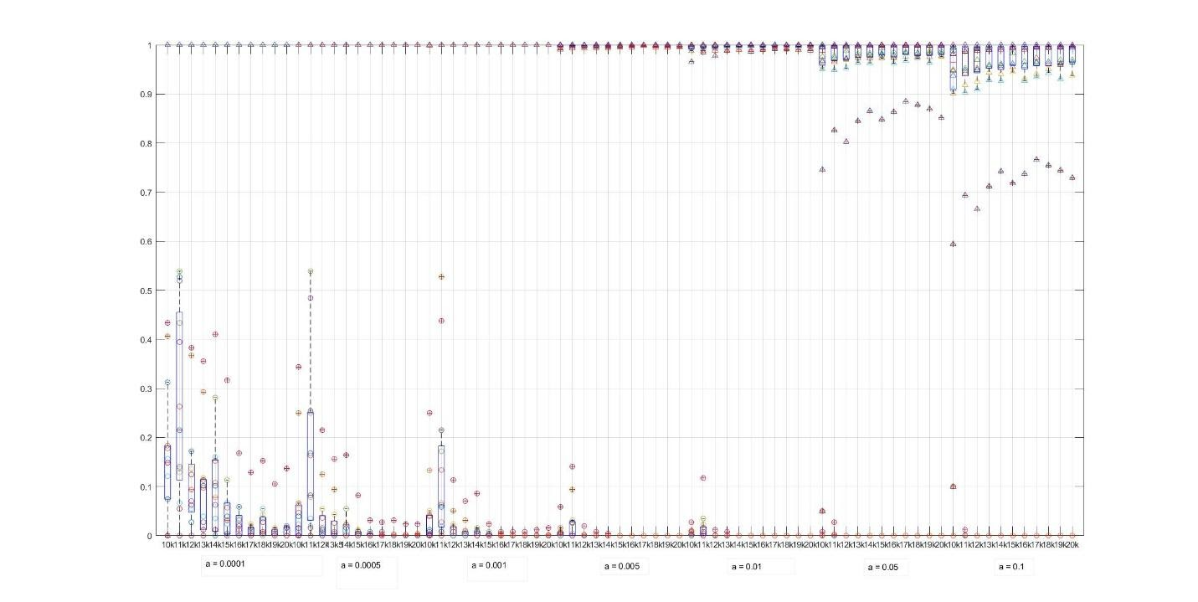
Spread Spectrum Results I
Audio Quality
Error Rate

Slide 15
Spread Spectrum Results II
Audio Quality
Error Rate

Slide 16
Questions?
Thanks for the listening!

Slide 17
Reference
[1] S. Katzenbeisser, and F. A. P. Petitcolas, Information Hiding Techniques for Steganography and Digital Watermarking, Artech House, Inc. 2000.
[2] Y. Stamatiou and D. Koukopoulos, "Digital Audio Watermarking Techniques for MP3 Audio Files," Digital Audio Watermarking Techniques and Technologies: Applications and Benchmarks, pp. 205-228, 2008.
[3] W. Bender, D. Gruhl, N. Morimoto and A. Lu, "Techniques for data hiding," in IBM Systems Journal, vol. 35, no. 3.4, pp. 313-336, 1996.
[4] Y. Suzuki, R. Nishimura and B. Ko, "Advanced Audio Watermarking Based on Echo Hiding: Time-Spread Echo Hiding," Digital Audio Watermarking Techniques and Technologies: Applications and Benchmarks, pp. 123-151, 2008.
[5] X. He and M. Scordilis, "Spread Spectrum for Digital Audio Watermarking," Digital Audio Watermarking Techniques and Technologies: Applications and Benchmarks, pp. 11-49, 2008.

