Slide 1
Automatic Modal Shifting Using Chromagrams & a CNN
By Miller Hickman and Alex Mancuso

Slide 2
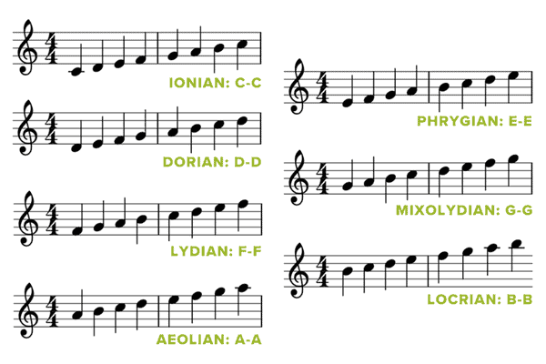
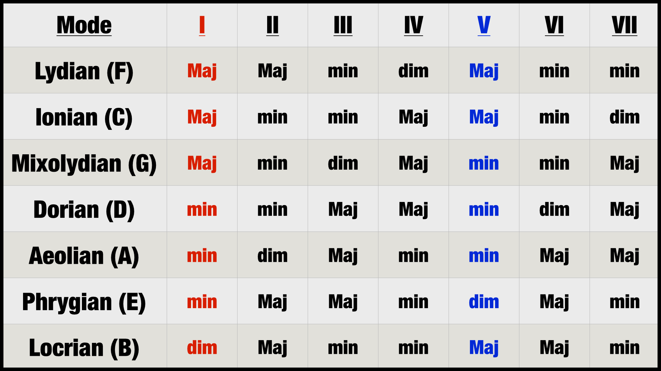
What is Modal Shifting?
Changing the pitches and chord tonalities of a given song to match another mode
E.g. shifting a song in ionian (major) to be in aeolian (minor)
https://www.musicnotes.com/now/wp-content/uploads/Modes-White-Keys-1.png
Mode: the way notes are spaced in a scale
Tonality: the quality of a chord (major, minor, diminished, etc.)
http://professionalcomposers.com/wp-content/uploads/2020/10/Chord-Chart-for-All-7-Modes-Triad-Chords.png

Slide 3
Goal
Design Considerations
Input has to be individual, separated stems
Works best with synthesizer tones
Input needs to be free of embellishments (bends)
Chords are limited to Major, Minor, Diminished
7th chords included
No inversions
Original key & mode + target key & mode are defined by the user
Shift the stems of a song from one key and mode to another

Slide 4
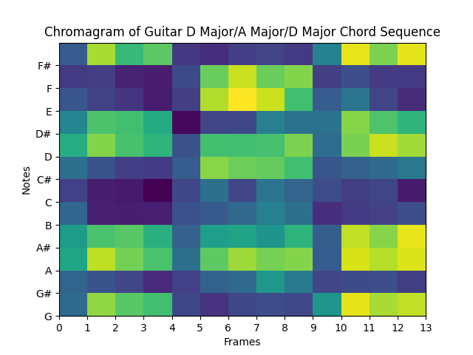
Pitch Detection and Chord Extraction
Used a chromagram calculated through Pitch Class Profile (PCP) from Constant-Q Transform, using kernels and FFT
Distinct streams were counted as separate events
Pychord library used to extract chord names
Music21 library used for chord qualities

Slide 5
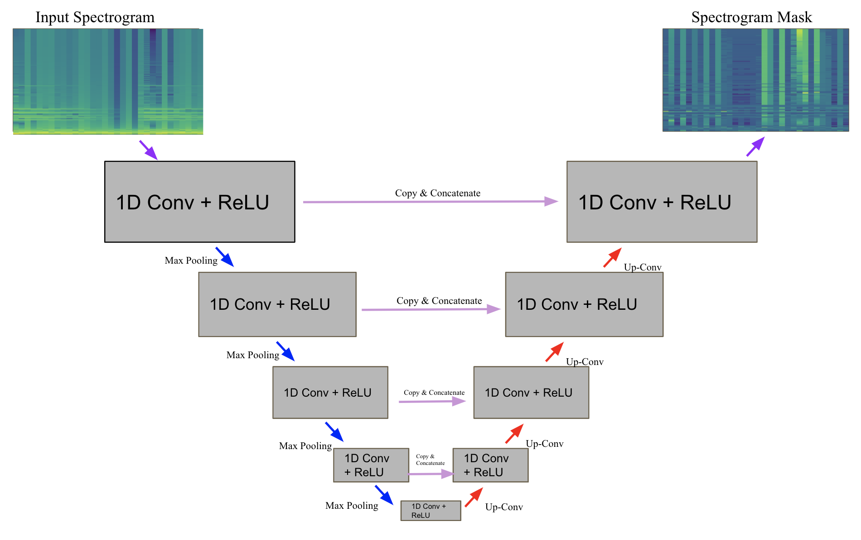
Tonality Shifting
CNN based off of U-Net architecture to implicitly shift the tonality of a given chord
Task treated similarly to a source separation problem
MSE Loss on magnitude spectrogram
Separate models trained for each pairwise tonality combination
major to minor, minor to diminished, etc.

Slide 6
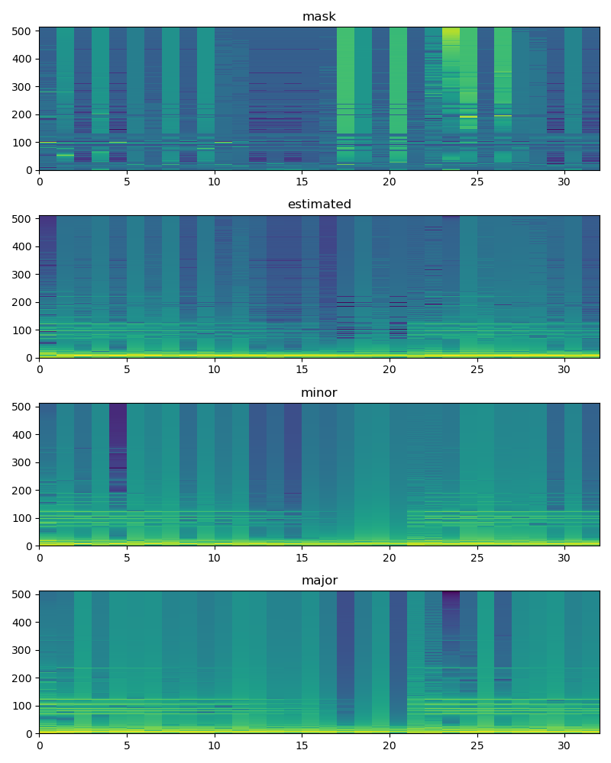
Data and Training
Data collection was a major problem
Trained tonality shifting with 6 different synthesizer sounds from PySynth
Major to Minor and Minor to Diminished models achieved satisfactory loss and results
Only Chords with a root note of C were used for training
On inference chords are pitch shifted to C before tonality shifting
Unable to achieve respectable loss values with Diminished to Major model

Slide 7
Bringing It All Together
Determine Scale Degree in Original Key
Read Audio Files
Chord
Calculate Chromagram
Determine desired tonality in new mode
Extract Pitches
Single Pitch
Tonality Shift
Retrieve Chord Names/Chord Qualities
Pitch Shift

Slide 8
Results
Major C (Input)
Minor C (Output)
Works better for single-note melodies
Tonality shifting and chord detection is not accurate enough to demonstrate market usefulness
Some artifacts in tonality shifting output
Note detection yielded errors when the input contained embellishments
Pitch extraction thresholds needed to be adjusted often
Minor C (Input)
Diminished C (Output)
Major Melody (Input)
Minor Melody (Ground Truth)
Melody Through Our Model (Output)

Slide 9
Future Work and Possible Improvements
Allowing user input to simply be an audio file
Requires source separation
More effective Tonality Shifting
Wider breadth of timbres for Tonality Shifting
Automatic key detection
More efficient note detection from chromagram
Ability to account for bends, embellishments in note stream detection
Including more notes in detection for complex chords

Slide 10
Questions?

Slide 11
References
[1] Brown, Judith & Puckette, Miller. (1992). "An efficient algorithm for the calculation of a constant Q transform". Journal of the Acoustical Society of America. 92. 2698. 10.1121/1.404385.
[2] PySynth, “PySynth - a Music Synthesizer for Python,” https://mdoege.github.io/PySynth/ (accessed Dec. 5, 2022)
[3] Q. Xi, R. Bittner, J. Pauwels, X. Ye, and J. P. Bello, "Guitarset: A Dataset for Guitar Transcription", in 19th International Society for Music Information Retrieval Conference, Paris, France, Sept. 2018.
[4] Ronneberger, O., Fischer, P., Brox, T. (2015). U-Net: Convolutional Networks for Biomedical Image Segmentation. In: Navab, N., Hornegger, J., Wells, W., Frangi, A. (eds) Medical Image Computing and Computer-Assisted Intervention – MICCAI 2015. MICCAI 2015. Lecture Notes in Computer Science(), vol 9351. Springer, Cham. https://doi.org/10.1007/978-3-319-24574-4_28
[5] Stoller, Daniel & Ewert, Sebastian & Dixon, Simon. (2018). Wave-U-Net: A Multi-Scale Neural Network for End-to-End Audio Source Separation.

Slide 12
Input Spectrogram
Spectrogram Mask
1D Conv + ReLU
1D Conv + ReLU
Copy & Concatenate
Max Pooling
Up-Conv
1D Conv + ReLU
Copy & Concatenate
1D Conv + ReLU
Max Pooling
Up-Conv
1D Conv + ReLU
Copy & Concatenate
1D Conv + ReLU
Max Pooling
Up-Conv
1D Conv + ReLU
Copy & Concatenate
1D Conv + ReLU
Max Pooling
Up-Conv
1D Conv + ReLU

