Slide 1
Energy-Informed NMF for Piano MIDI Transcription
Ben Kevelson & Teghan Murray

Slide 2
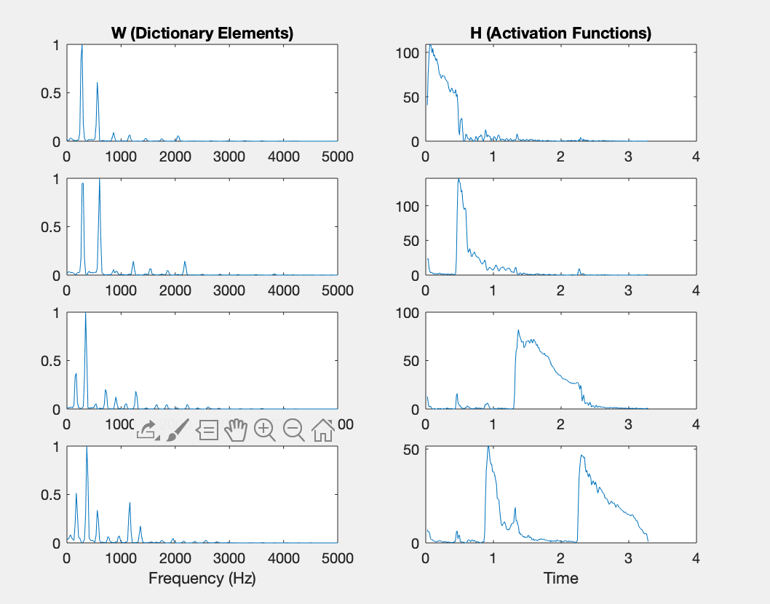
Introduction and Motivation
NMF can be used to identify notes in musical signals
This 4-element NMF learns the 4 piano notes played in this audio file
If we train an NMF to learn a single piano note for each element, we can use the output activation function for polyphonic transcription

Slide 3
NMF Methods

Slide 4
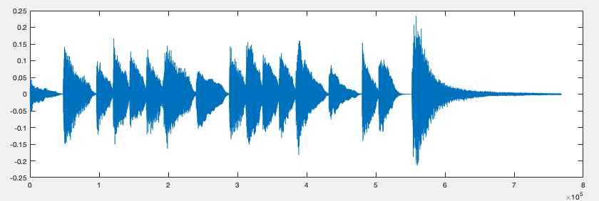
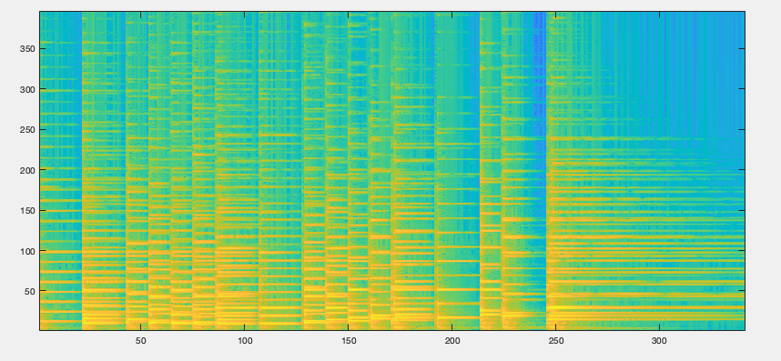
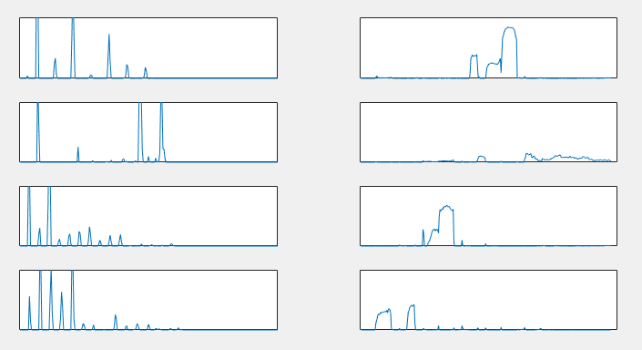
Basic Process / Recap
Take STFT of piano recording
Use linear magnitude spectrogram (V) to iteratively approximate template vectors (W) and activation vectors (H)
KL Divergence acts as a loss function, vectors W and H are updated on each iteration
Parameter r determines # of W and H vectors
NMF
r = 4

Slide 5
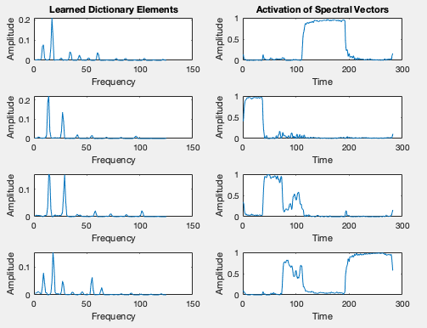
NMF for Piano Transcription
W
H
When applying NMF to piano recordings:
W represents the template (harmonic structure) of each note
H represents the activation of each note (when it is ringing)
Baseline NMF method has various shortcomings:
When W and H are randomly initialized, they may not be representative of a single note
General inaccuracy, octave errors
Hard to determine r value

Slide 6
Extended NMF Methods
Baseline method
Ewert and Müller [1] propose:
Initializing template vectors of W using a rough harmonic approximation of each note
Initializing activation vectors of H using MIDI score information
These constraints increase accuracy and robustness of NMF approximation for piano recordings
Initialization method
[1] Ewert and Müller

Slide 7
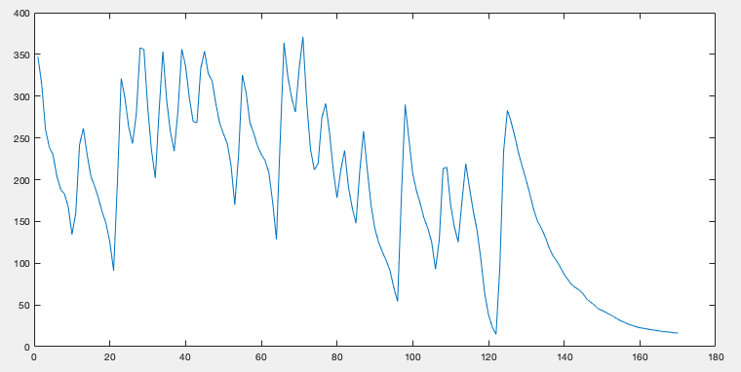
Our Methods
We apply Ewert & Müller’s method of template vector initialization
However, their method leverages MIDI transcriptions for initialization of H, whereas our method seeks to create MIDI transcriptions
Thus, we created a method where the activation vectors of H are initialized using a normalized, frame-by-frame summation of the magnitude
This increases onset accuracy for calculated H vectors, intended to increase MIDI transcription accuracy

Slide 8
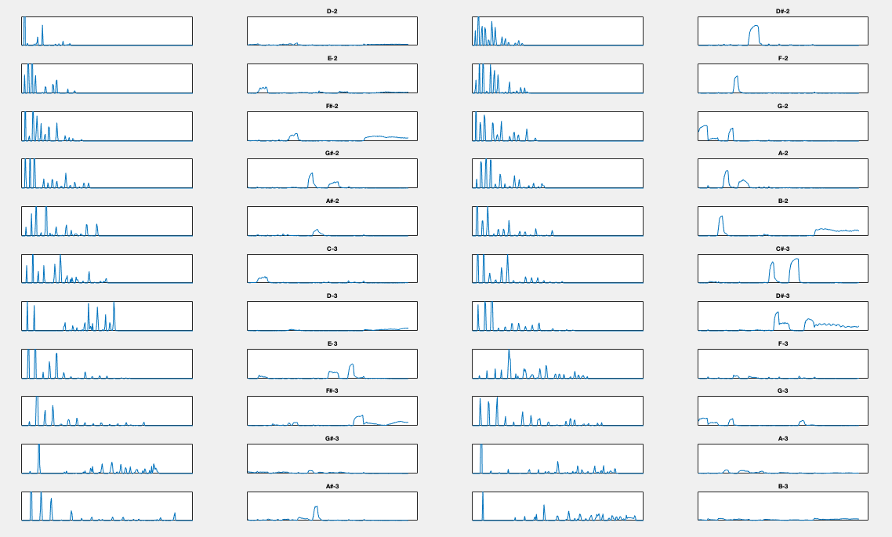
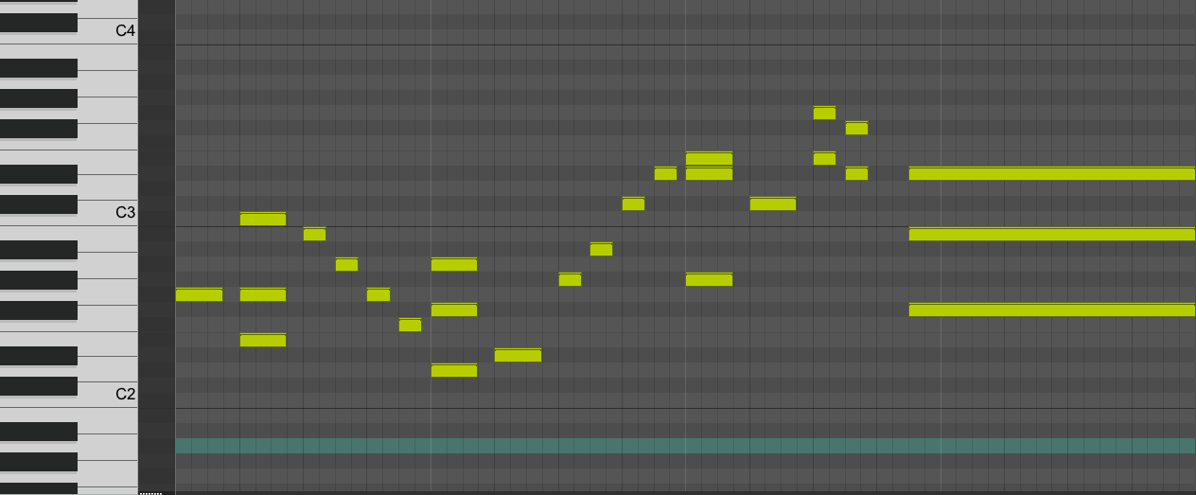
NMF Results

Slide 9
MIDI Transcription

Slide 10
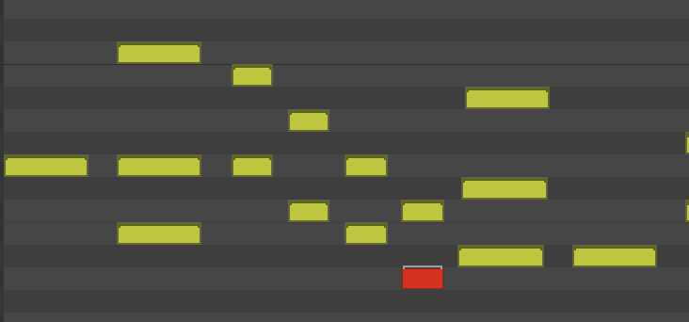
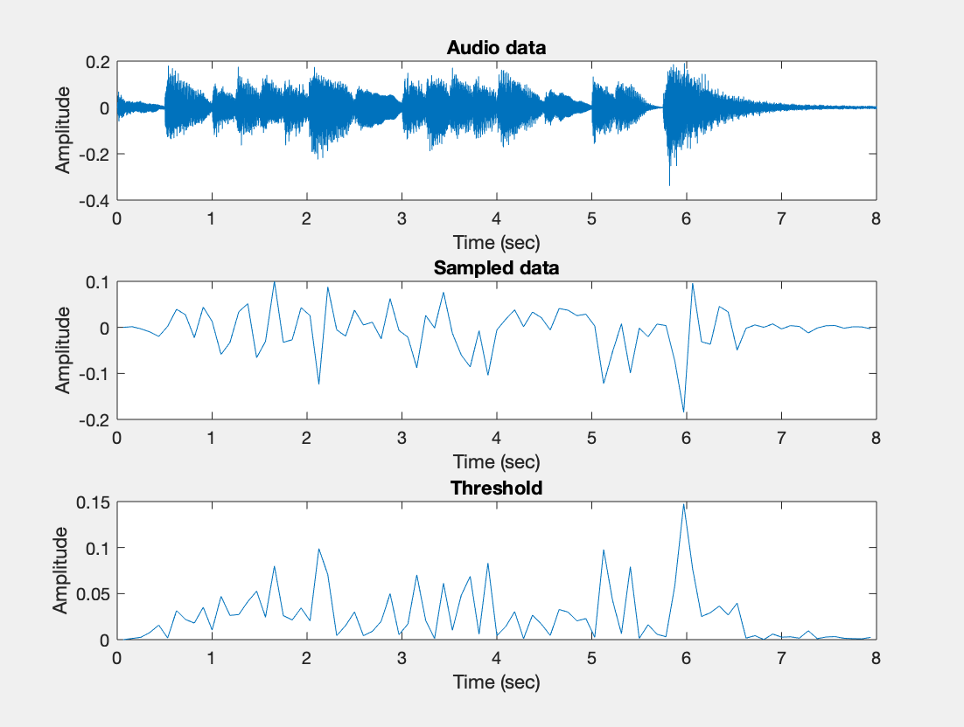
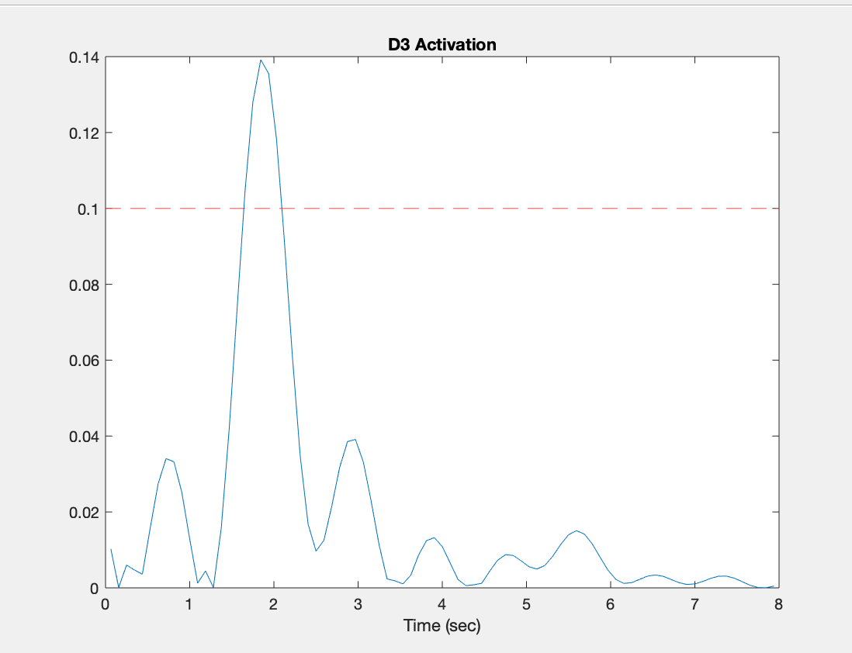
MIDI Transcription
Thresholding:
Most simple way is to threshold each activation function
Adaptive thresholding:
Follow amplitude of the input data to determine threshold for each frame
Create NoteOn and NoteOff messages with the timing from the threshold and the note number from the dictionary elements

Slide 11
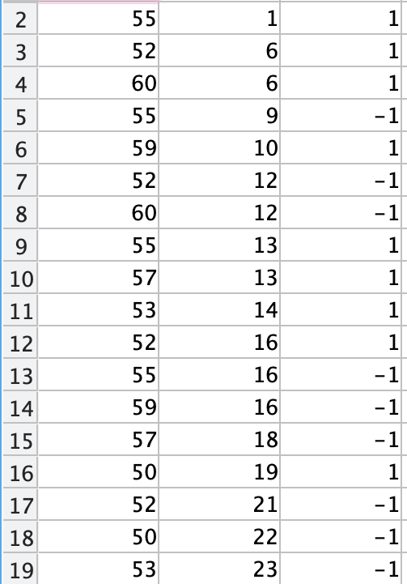
Timing (Frames):
Status (On/Off):
Note #:
Beginning of file
End of file
[3] Expanded MIDI 1.0 Messages List (Status Bytes)

Slide 12
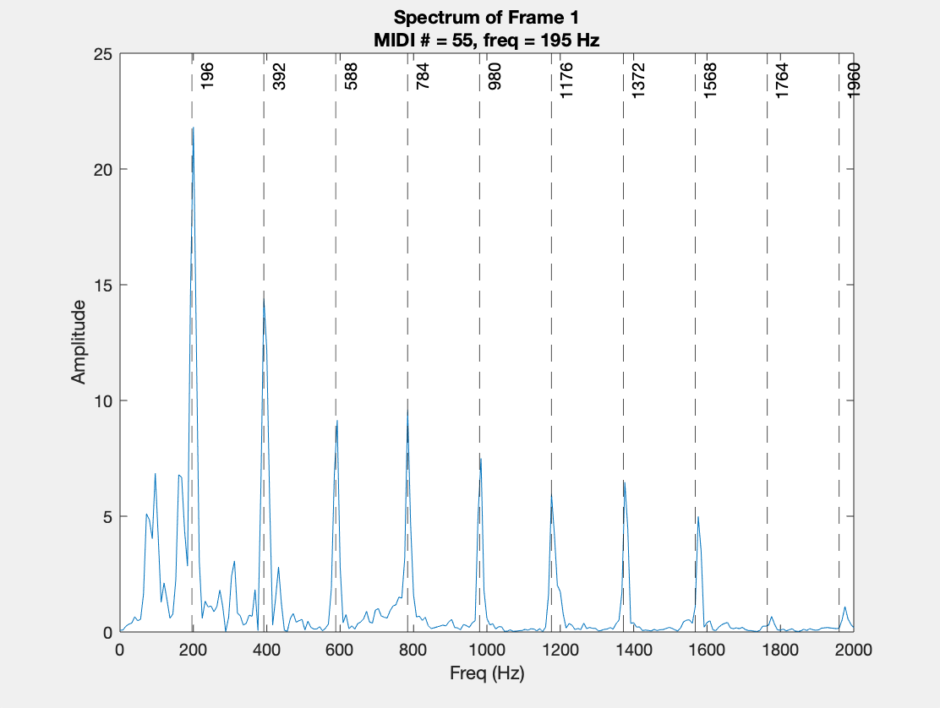
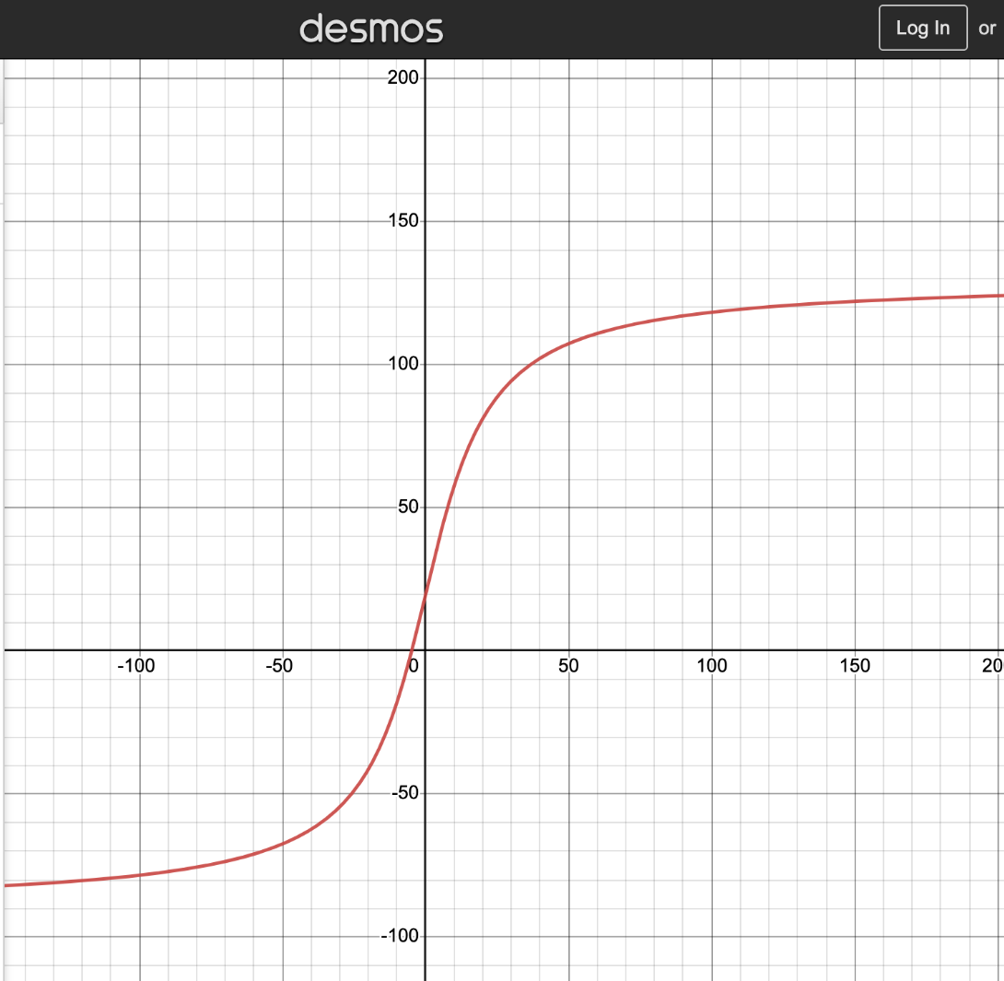
Velocity
To determine velocity, we sum the harmonic peaks of the note
Polynomial interpolation
Then, we find a line of best fit
Atan function
To find velocity, sum the peaks then plug into function
Notes:
To find line of best fit:
-Series of notes with known velocities
-Take the STFT (linear magnitude spectrum)
-Midi note # -> fundamental frequency -> list of harmonics
-Find the harmonics in the frequency spectrum of the relevant window (using interpolation)
-Sum the first ten harmonics
-Plot the velocity vs. the sum and find a line of best fit, which we altered to be an arctangent function
To find velocity:
-Do the same procedure; you know the midi #, so you know the fundamental and harmonic frequencies
-Find the harmonics in the frequency spectrum (again, use interpolation)
-Sum the harmonics
-Plug into line of best fit

Slide 13
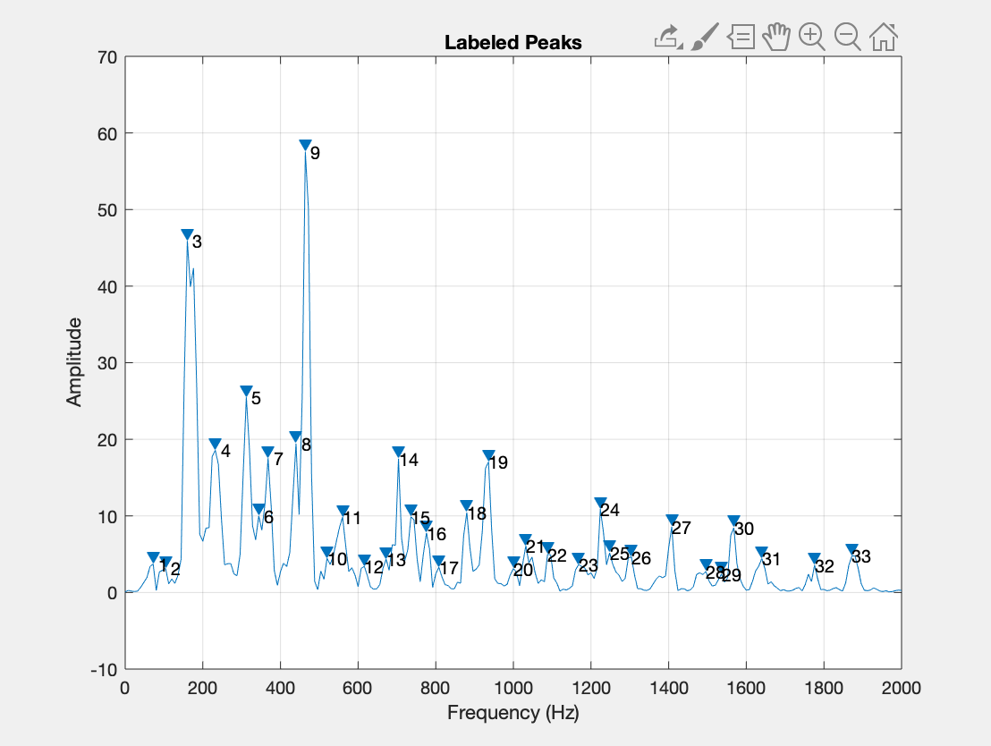
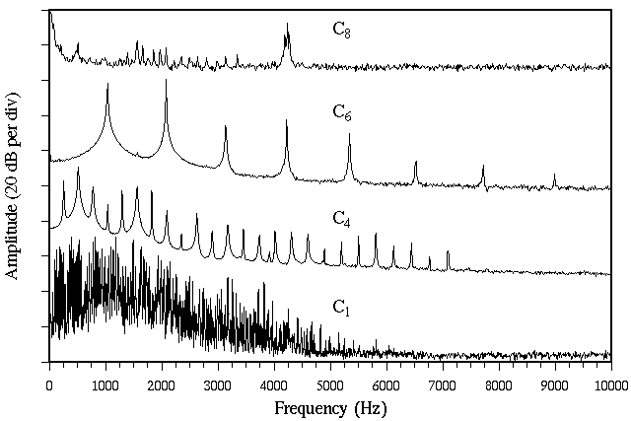
Octave Error Correction
MIDI #s:
50
53
58
70
MIDI Note #: 50
Fundamental frequency: 146.8 Hz
# of harmonics in the 0-2000Hz range: floor(2000/146.8) = 13
MIDI Note #: 53
Fundamental frequency: 174.6 Hz
# of harmonics in the 0-2000Hz range: floor(2000/174.6) = 11
MIDI Note #: 70
Fundamental frequency: 466.2 Hz
# of harmonics in the 0-2000Hz range: floor(2000/233.1) = 4
Total # of peaks: 28
MIDI Note #: 50
Fundamental frequency: 146.8 Hz
# of harmonics in the 0-2000Hz range: floor(2000/146.8) = 13
MIDI Note #: 53
Fundamental frequency: 174.6 Hz
# of harmonics in the 0-2000Hz range: floor(2000/174.6) = 11
MIDI Note #: 58
Fundamental frequency: 233.1 Hz
# of harmonics in the 0-2000Hz range: floor(2000/233.1) = 8
Total # of peaks: 32
Similar method to velocity: use the harmonic peaks to determine what octave is actually being played
Upper octaves will have more spaced out harmonics
Count the peaks in a window to determine correct harmonic
[3] D. A. Russell, “Hammer nonlinearity, dynamics and the piano sound,”
Notes:
-More harmonics = lower octave
-Check dictionary elements to make sure they learned correct octaves
-Look at activation functions; around ~2 seconds, A#4 is highly activated, but the ground truth is for A#3
To correct for octave errors:
-Select frames where notes an octave apart (±12 dictionary elements) have onsets at the same frame
-Pull out magnitude spectrum of that frame
-Limit the frequency range of that spectrum (0-2000 Hz)
-Using all of the other notes that are on at that frame, calculate the theoretical # of peaks present for each activated octave

Slide 14
Results
With random H-initialization:

Slide 15
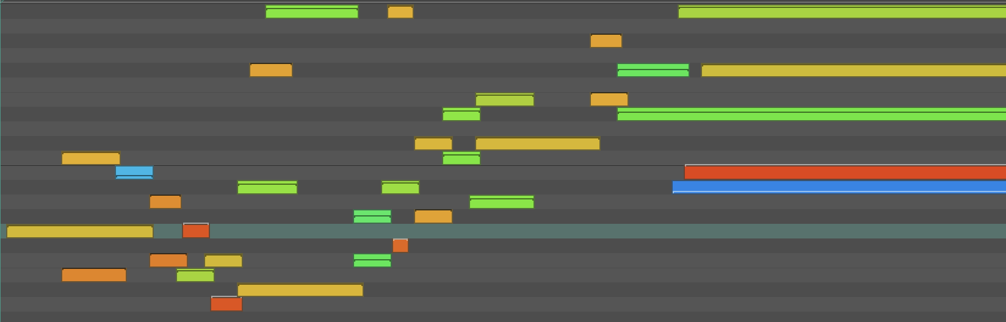
Results
Smart H-initialization:

Slide 16
Results
Results are promising; we can correct octave errors, and the timings are close
The STFT resolution tradeoff is an ongoing issue
The smart H-initialization improves timing, but creates additional octave errors
The random H-initialization has worse timing, but less octave errors

Slide 17
References
[1] Ewert, S., & Müller, M. (2012). Using score-informed constraints for NMF-based source separation. IEEE Xplore. Retrieved December 5, 2022, from https://www.semanticscholar.org/paper/Using-score-informed-constraints-for-NMF-based-Ewert-M%C3%BCller/baa567da56f5ac88f24a628f147b0cb682a2a918
[2] “Convert MIDI files into MIDI messages,” Convert MIDI Files into MIDI Messages - MATLAB & Simulink. [Online]. Available: https://www.mathworks.com/help/audio/ug/convert-midi-files-into-midi-messages.html. [Accessed: 14-Dec-2022].
[3] “Expanded MIDI 1.0 Messages List (Status Bytes),” midi.org. [Online]. Available: https://www.midi.org/specifications-old/item/table-2-expanded-messages-list-status-bytes. [Accessed: 14-Dec-2022].
[4] D. A. Russell, “Hammer nonlinearity, dynamics and the piano sound,” Hammer nonlinearity, dynamics and the Piano Sound, 1997. [Online]. Available: https://www.acs.psu.edu/drussell/Piano/Dynamics.html. [Accessed: 14-Dec-2022].

Slide 18
Questions?

