Slide 1
Automatic Drum Transcription
Using RNN Source Separation and Energy-Based Onset Detection

Slide 2
Background
Automatic Drum Transcription (ADT) is an extremely useful tool in music education and production
Like automatic transcription on other instruments, aims to aid the user in learning/manipulating a part without relying on just their ears
Most modern ADT algorithms rely on machine learning for accurate source separation

Slide 3
Motivation
Basic Idea: Create an algorithm which can take in a solo drum track, separate percussive sources, and transcribe them into separate files
Use Recurrent Neural Networks (RNN) model to separate simple drum features:
Kick drum
Snare drum
Hi Hat cymbals
Output an “onset file” which contains shorts bursts of white noise corresponding to every hit

Slide 4
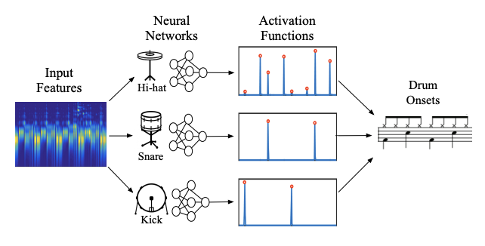
Basic Data Pipeline
Methods
Audio > Spectrogram > NN > Separation > Onsets
https://www.open-access.bcu.ac.uk/4101/

Slide 5
Methods–Data Loading
For all input audio, including training data, the sound file is summed to mono and transformed into a spectrogram
As shown below, spectrograms for percussive sources have very clear and strong onsets:

Slide 6
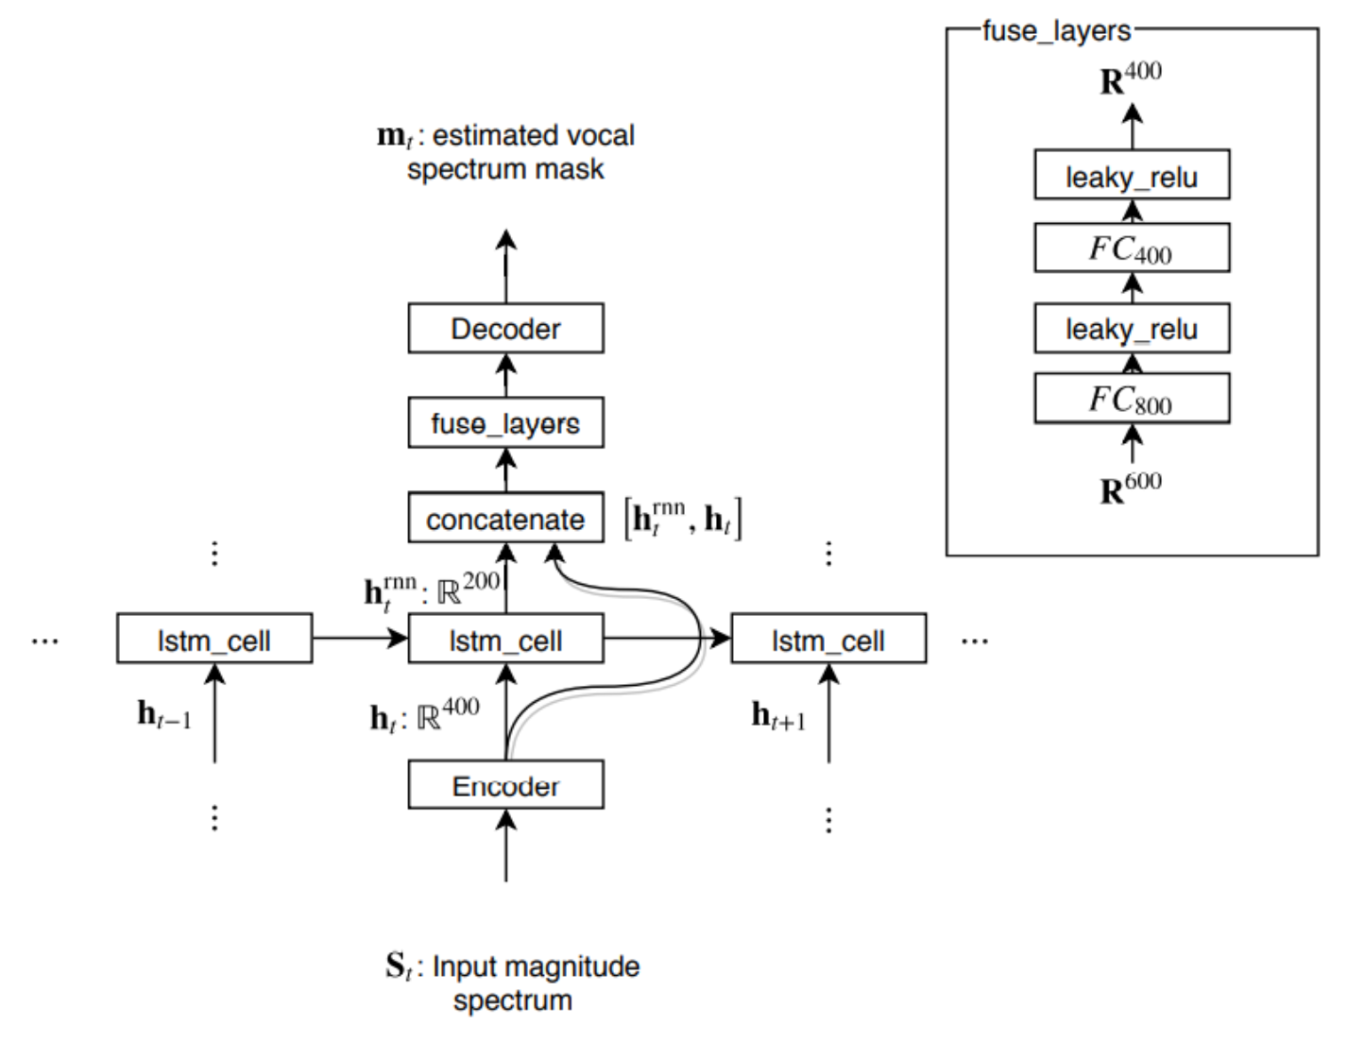
Methods–RNN Model
Source separation performed using RNN architecture shown to the right
RNNs include data from previous steps, allowing understanding of temporal information
Model was trained three times using separation data for the kick, snare and hihat in each mixture
https://link.springer.com/chapter/10.1007/978-3-319-53547-0_31

Slide 7
Methods–Training
Initial training library consisted of 16 drums mixtures, each with corresponding kick, snare and hihat separated tracks (.wav with sample rate 44100 Hz)
Each mixture varies in style, pattern, and kit timbre for a diverse set of data
Very few public datasets exist for solo drum separation, so all drum samples are from the Logic Pro X drummer library

Slide 8
Methods–Onset Detection
After being separated from the mixture, each drum track is passed through a simple energy-based onset detection function
This takes in the audio sample data, windowing parameters, and a tunable threshold to return a .wav file containing a burst of white noise at each onset which falls above that threshold
Since we are dealing with percussive files, energy-based onset detection will provide accurate results and is easy to implement

Slide 9
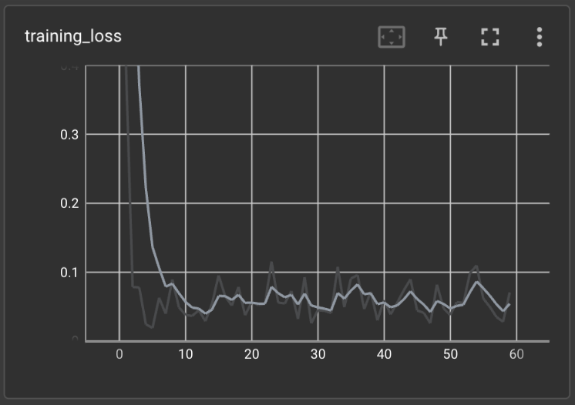
Results

Slide 10
Results–Source Separation
Separation results showed promisingly low loss from the target spectrograms
Separation on the test files (from the same sample library) performed extremely well, especially with the snare drum tracks
Having a limited dataset, the separation was not perfect for acoustic drum mixtures, and failed to identify unfamiliar sounds such as crash cymbals and auxiliary percussion

Slide 11
Results–SS Examples
Test File (from Logic Pro X):
Kick:
Snare:
Hi Hat:
Test File (acoustic recording):
Kick:
Snare:
Hi Hat:

Slide 12
Results–Onset Detection
Energy-based onset detection run on “TestSnare.wav”:
This method “cleans up” the transients of the output separations, due to the large number of artefacts they possess

Slide 13
Future Work & Research
Greatly increase data training library, include examples with other drum parts such as crash cymbals, toms, ride cymbals etc.
Try slightly different architectures, ones optimized for percussive source separation based on timbre e.g. Bidirectional Neural Networks
Work on an onset based score writing function which can use temporal information from onset files to

Slide 14
Questions?

Slide 15
References
R. Stables, J. Hockman, and C. Southall, “Automatic drum transcription using bi-directional recurrent neural networks.,” Welcome to BCU Open Access Repository, 07-Aug-2016. [Online]. Available: https://www.open-access.bcu.ac.uk/4101/. [Accessed: 06-Dec-2022].
A. Liutkus, F.-R. Stöter, Z. Rafii, D. Kitamura, B. Rivet, N. Ito, N. Ono, and J. Fontecave, “The 2016 Signal Separation Evaluation Campaign,” SpringerLink, 15-Feb-2017. [Online]. Available: https://link.springer.com/chapter/10.1007/978-3-319-53547-0_31. [Accessed: 06-Dec-2022].
C. Southall, C.-W. Wu, A. Lerch, and J. Hockman, “MDB drums: An annotated subset of MedleyDB for automatic drum transcription,” Welcome to BCU Open Access Repository, 23-Oct-2017. [Online]. Available: https://www.open-access.bcu.ac.uk/6179/. [Accessed: 06-Dec-2022].

