Slide 1
Thermodynamic Energy Balances in Solids
Special Lecture on using Jacobian Algebra
by S. J. Burns
High Energy Density Science
Materials Science Program
Mechanical Engineering Department
Introduction
Energy balances in fluids
Jacobians for transformations to other variables
Solids: mechanics of stress and strain
Energy balances in solids
Physical properties and elastic properties found using Gibbs like functions
Third order derivatives for thermodynamic identities
Example of a sheared solid with only three variables
Finding constant volume lines in solids

Slide 2
Introduction
Why study thermodynamics? Energy balances are universal but very different for each discipline: Physics, Chemistry, Biology, Engineering, Materials, etc. All have their own ‘Disciplines in Thermodynamics.’ Most don’t understand what the others do!!
Thermodynamics is always useful for finding self-consistent phenomena. Especially useful in complex chemical systems. Thermodynamics by itself predicts nothing. Assumptions about a system are often included in models of the phenomona!
Energy balances in the ‘First Law’ has been around for so many years it is indisputable. Entropy is very difficult to understand.
Key problem is to define the system: Closed or Open

Slide 3
Energy balances in fluids:
Construct a table that contains all the physical properties
Use Jacobian Algebra
Heat Capacity
Thermal Expansion
Isothermal compressibility
3rd order derivatives of Gibbs function (unique)
Easy to find all interrelations among properties

Slide 4
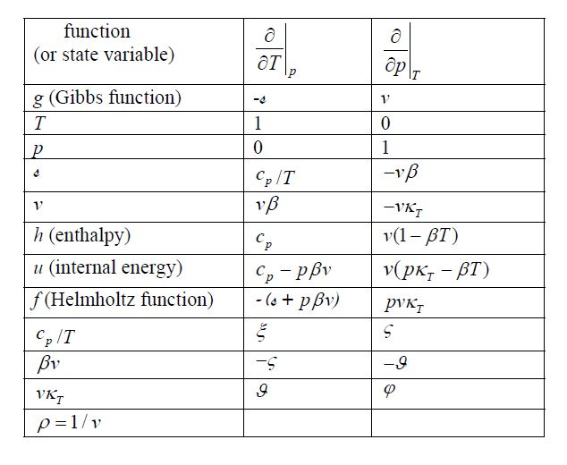
3rd Order Jacobian Table for a Fluid

Slide 5
You use this table to change variables in the system
Here is how it works:

Slide 6
Expand matrix Cramer’s rule

Slide 7
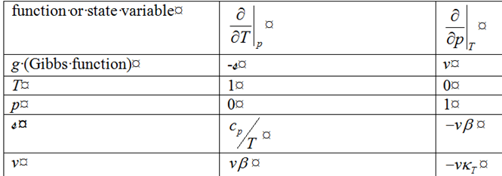
The Jacobian method works for stress and strain in thermo-elasticity
These systems have 7 independent variables.

Slide 8
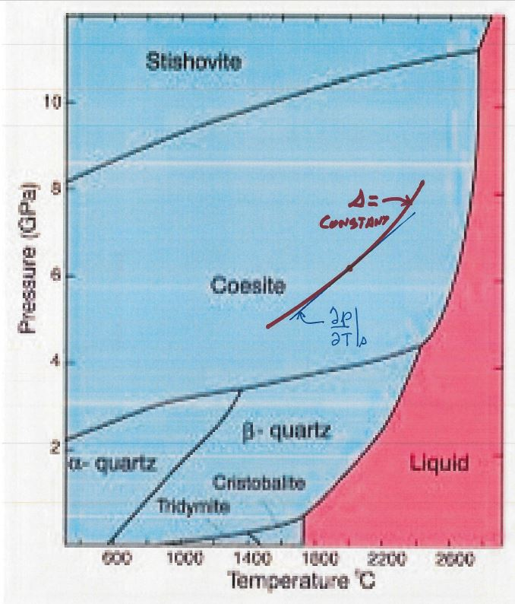
Phase Diagram
Pressure versus Temperature for Quartz

Slide 9
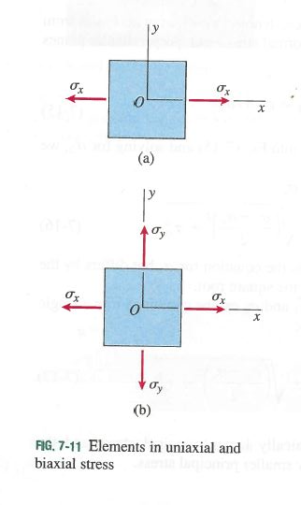
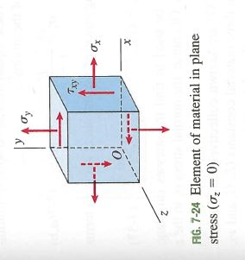
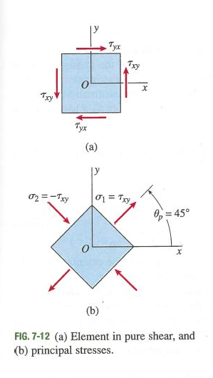
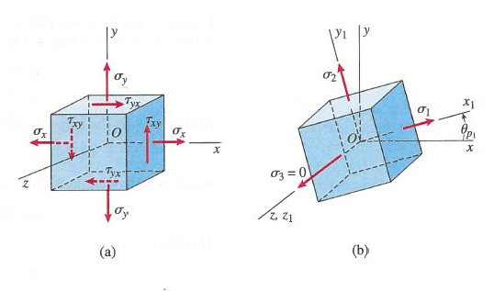
Mechanics of Stresses

Slide 10
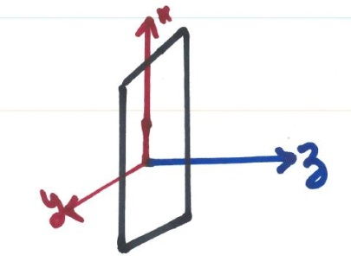
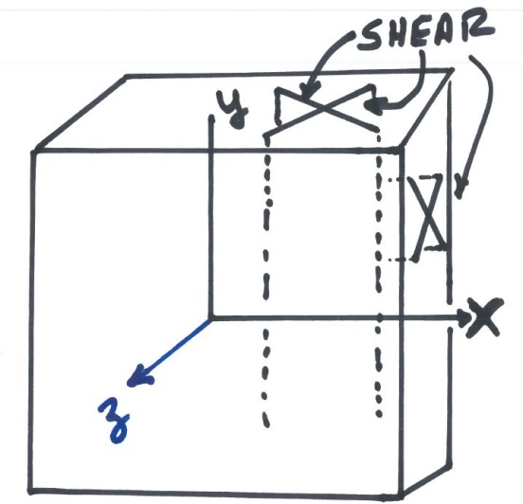
Hooke’s Law Applied to a Plane Wave
No strain in x and y, so stresses are equal
when material is isotropic
The z stress is from Poisson’s effect
The z strain is from Hooke’s law but we need adiabatic moduli and volume changes since stresses are huge.
Shear strains are through-the- thickness as shown not in-plane. Need strain volumes in energy balances. Volume change is seen above.

Slide 11
Fluids: First law of thermodynamics for a fluid like material
The system is per unit mass has 2 independent variables
Solids: First law for a solid material is more complex.
The system is per unit mass and has 7 independent variables
Strain volume is used in all my work:
For a solid 1st law:
In vector representation:
i = 1, 2 and 3 dilatational while 4, 5 and 6 deviatoric

Slide 12
Gibbs like free energy function with independent stresses:
So
The independent state variables (7 variables) are T and σi while the
equation is per unit mass.
1st derivatives of g gives the state variables
2nd derivatives of g gives the elastic and thermal properties
3rd derivatives of g gives interactions among properties
These third order quantities are new but mostly of academic interest
There are 196 3rd order terms and 77 new expressions as follows:

Slide 13
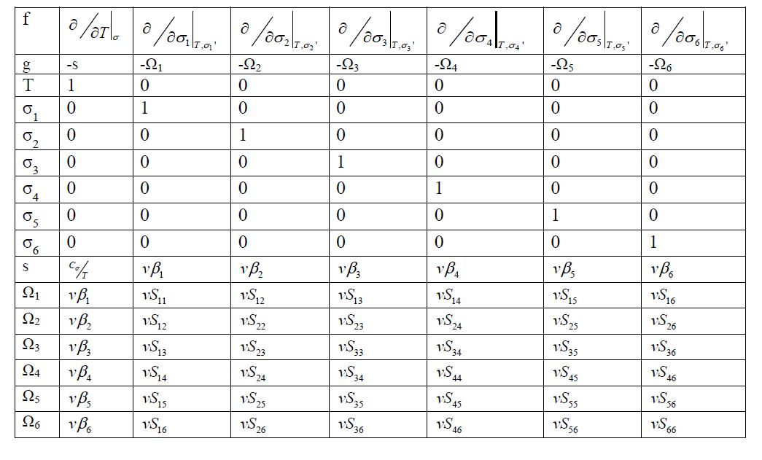
Jacobian table for a thermo-elastic solid with 6 independent stresses

Slide 14
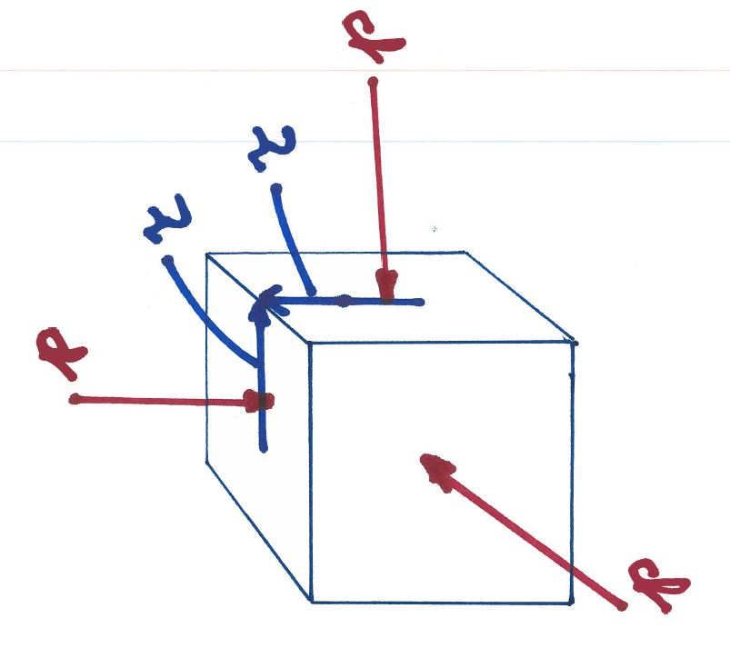
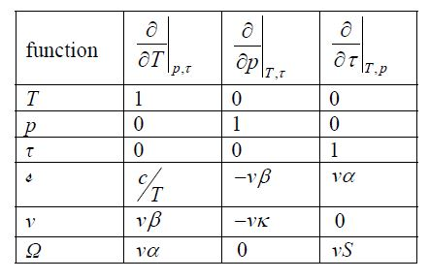
Solid with Applied Pressure and Applied Shear Stress
Use only a single shear
(there are 3 independent)
All entries in the Jacobian table to the right are definitions. c, β and α are heat capacity, volume thermal expansion and shear thermal expansion respectively. κ is compressibility. S is shear compliance.

Slide 16
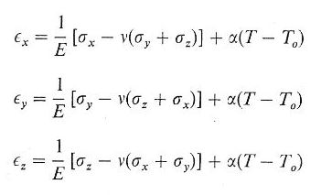
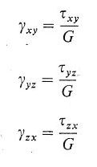
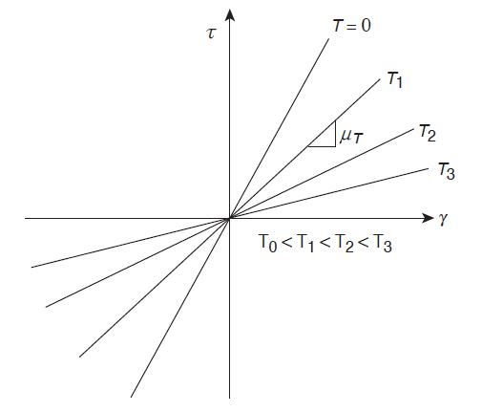
Hooke’s Law for isotropic materials for normal dilatational strains with thermal strains
Hooke’s Law in isotropic materials; shear strains have no thermal strains at zero stress.

Slide 17
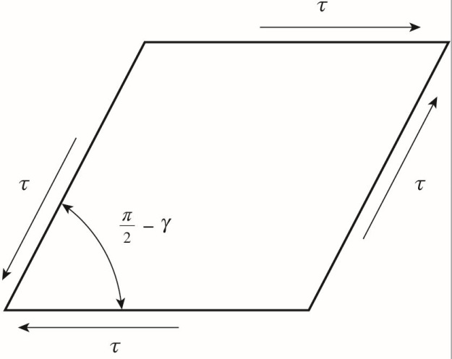
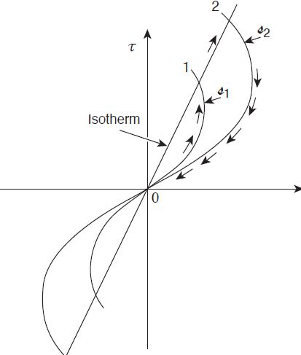
Engineering shear stress and strain
Adiabatic lines must not cross as shown to the left
If the adiabatic lines cross 2nd law of thermo is violated
in the Kelvin - Planck statement

Slide 18
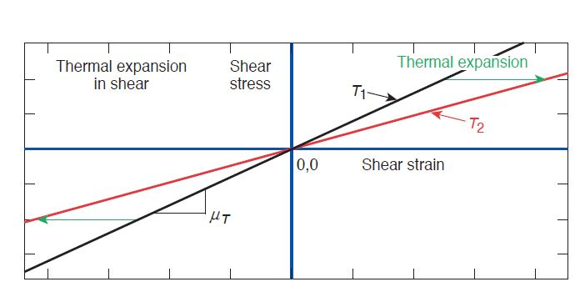
No corrections from isothermal to adiabatic for shear waves
reason: thermal expansion coefficient is zero but only at zero stress!
In shear, thermal expansion coefficient is only zero at zero stress/strain.
That is only at one point on the shear stress vs shear strain system.
Points in thermo systems: triple point, critical point, spinodal point, etc.

Slide 19
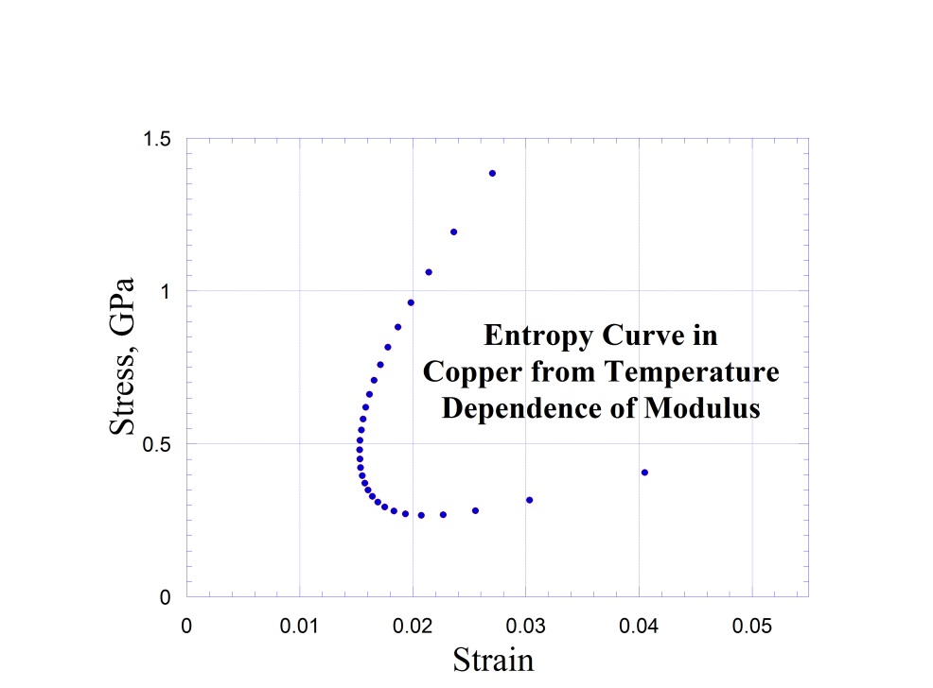
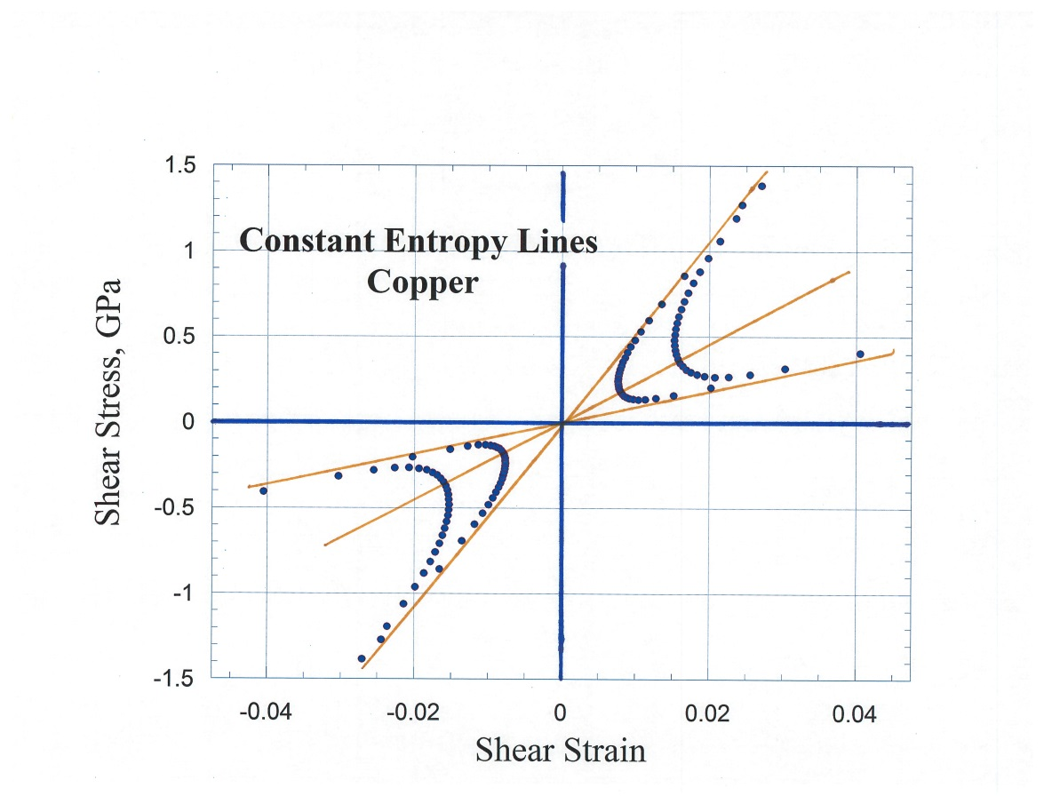
Here is a curve for entropy in shear in copper
All the entropy lines are repulsed away from the point of zero stress - zero strain. All the isotherms must go through that point.

Slide 20
Derivation of entropy lines from shear with isothermal linear stress vs strain

Slide 21
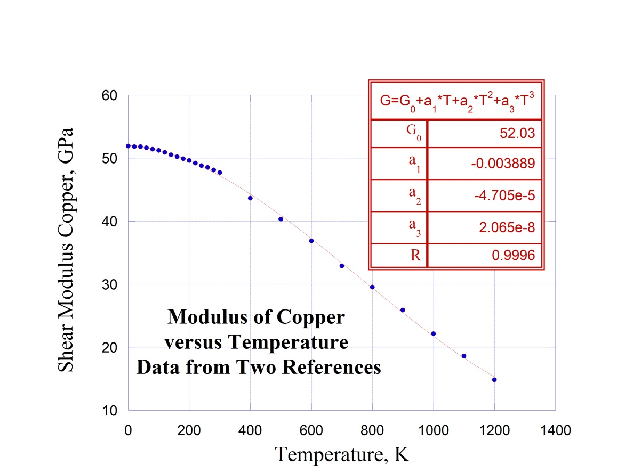
Modulus vs Temperature
Matched low and high temperature
Data sets at T = 300K
At the “Repulsion Point ” we have:
All values of T and all values of P

Slide 22
Solve the differential equation at the “Repulsion Point” for the slope of an adiabatic line

Slide 23
Experimentally Measure Temperature and Pressure
In a plot of pressure versus temperature for a given material I’d like to find the line that keeps the volume constant:

Slide 24
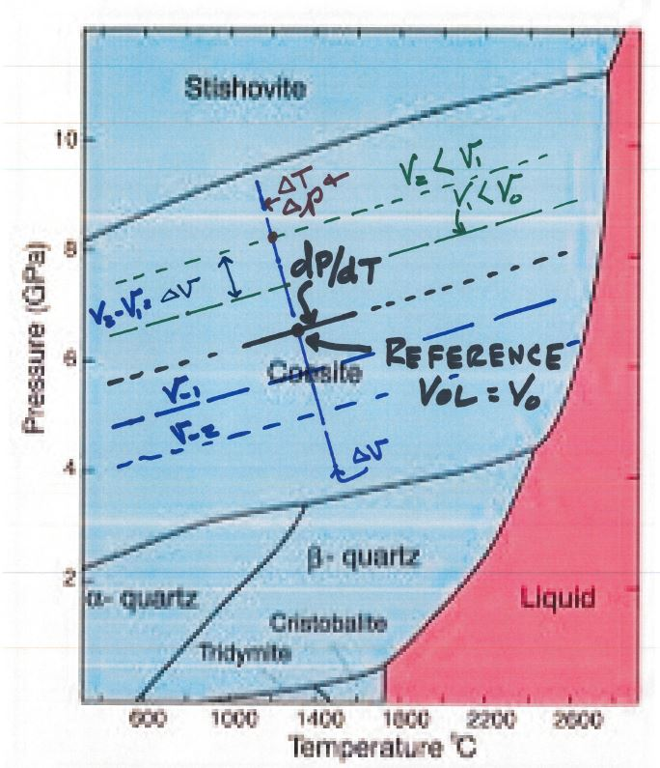

Slide 25
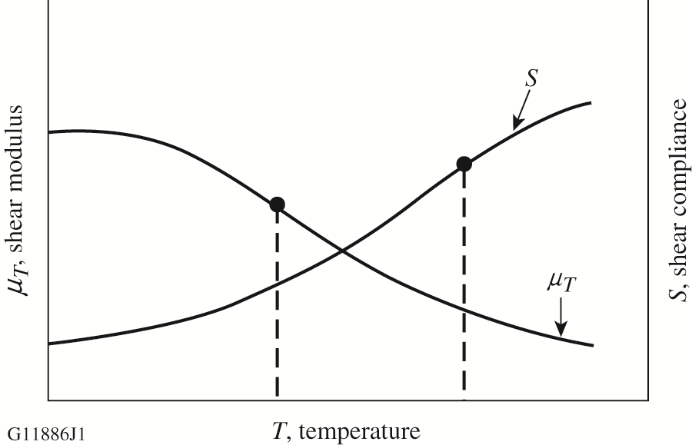
Stability: Entropy vs Temperature where does it change sign?
When the Curvature Changes Sign: Use Modulus when the Strain is Constant
Use the Compliance when Stress is Constant

Slide 26
Conclusions
Shear modulus depends only on the specific volume
The volume depends on the temperature and pressure
Shear changes the shape of a solid but not the volume
The value of m describes entropy slopes in shear and also atomic compression
Isothermal lines are isochoric lines in shear systems
Bulk modulus obeys ‘Repulsion Point’ thermoelasticity
Solids really are very, very different from gases!
Two of three phonons are in shear. Constant stress free energies are about 85% from shear energies
This universal shear law should have been found quite some time ago!! Most solids are liquids in literature.

